Slide 1









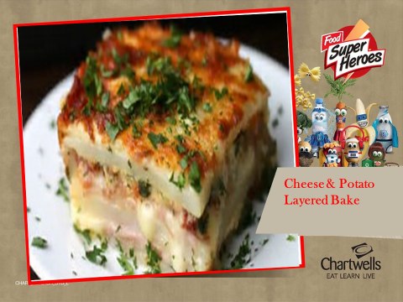

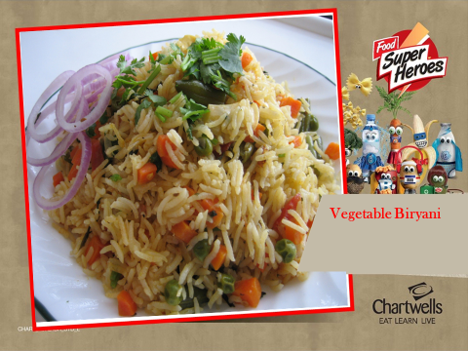




Week Commencing; 30/10/17, 20/11/17, 11/12/2017, 01/01/2018, 22/01/2018, 12/02/2018, 05/03/2018, 26/03/2018
Week One
There is a vegetarian choice every day... and don’t forget that salad is available daily
Monday
Choose a main meal...
Vegetable Supreme Pizza & Wedges
Neapolitan Pasta
Ham Sandwich
on the side...
Carrots
Peas
for dessert...
Wedges of Melon & Orange
Or
Yoghurt
Tuesday
Choose a main meal...
Beef & Vegetable Pie with New Potatoes
Mexican Vegetable Chilli with Rice
Cheese Roll
on the side...
Green Beans
Cauliflower
for dessert...
Pineapple & Peach Crumble* with Custard
Or
Whole Fruit
If you don’t fancy dessert enjoy fresh fruit or yoghurt
Wednesday
Choose a main meal...
Roast Turkey and Bud’s Crispy
Spud
Cheese & Potato Bake
Egg Mayo Sandwich
on the side...
Carrots
Broccoli
for dessert...
Fruity Apricot Bar
Or
Fruit Salad
Thursday
Choose a main meal...
Chinese Chicken Noodles
Vegetable Biryani
Tuna Mayo Wrap
on the side...
House coleslaw
Sweetcorn
for dessert...
Fruit in Jelly
Or
Whole Fruit
Chinese Noodles
Friday
Choose a main meal...
Crispy Fish & Chips
Quorn Hotdog & Chips
Turkey Sandwich
on the side...
Baked Beans
Peas
for dessert...
Chocolate & Banana Muffin
Or
Fruit Salad
Keep yourself topped up with water
– it will help you concentrate all day long
Salad Bar, Freshly Baked Bread, Fruit and Fresh Water available daily.
* 50% Fruit Based Desert

Slide 2


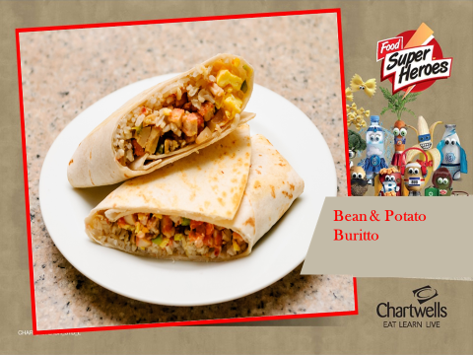
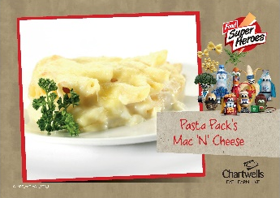





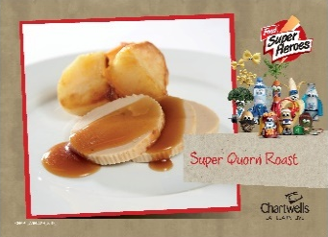
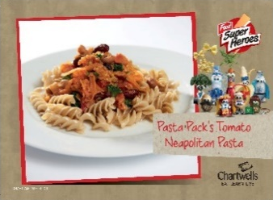
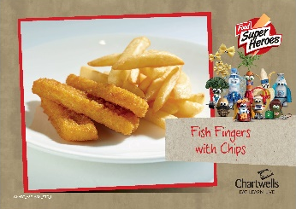

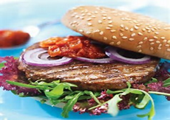
Week Commencing; 06/11/2017, 27/11/2017, 18/12/2017, 08/01/2018, 29/01/2018, 19/02/2018, 12/03/2018, 02/04/2018
Week Two
There is a vegetarian choice every day... and don’t forget that salad is available daily
Monday
Choose a main meal...
Mac ‘N’ Cheese
Bean and Potato Burrito
Ham Sandwich
on the side...
Broccoli
Crunchy Salad
for dessert...
Chocolate & Mandarin Sponge*
& Chocolate Sauce
Or
Fruit Salad
Tuesday
Choose a main meal...
Pork Sausages, Mashed Potato & Gravy
Vegetarian Sausages, Mashed Potato & Gravy
Cheese Roll
on the side...
Carrots
Broccoli
for dessert...
Strawberry Cheesecake
Or
Whole Fruit
If you don’t fancy dessert enjoy fresh fruit or yoghurt
Wednesday
Choose a main meal...
Roast Chicken & Bud’s Crispy Spuds
Quorn Roast & Bud’s Crispy Spuds
Egg Mayo Sandwich
on the side...
Peas
Swede
for dessert...
Peaches with Homemade Granola & Yoghurt
Or
Fruit Salad
Thursday
Choose a main meal...
Beef Chilli with Rice & Pitta
Creamy Tomato & Basil Pasta
Tuna Mayo Wrap
on the side...
Sweetcorn
Green Beans
for dessert...
Jam & Coconut Sponge
Or
Whole Fruit
Friday
Choose a main meal...
Golden Fish Fingers
Quorn Burger
Turkey Sandwich
on the side...
Baked Beans
Crunchy Light ‘Slaw
for dessert...
Oatie Biscuit
Or
Fruit Salad
Quorn
Burger
Keep yourself topped up with water
– it will help you concentrate all day long
Salad Bar, Freshly Baked Bread, Fruit and Fresh Water available daily.
*50% Fruit Based Desert

Slide 3

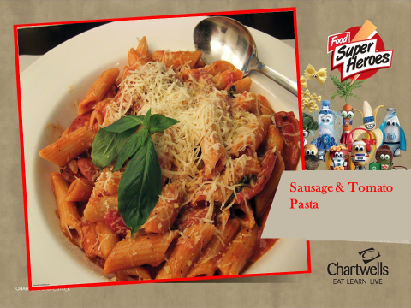






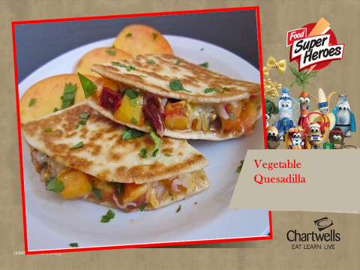

Week commencing; 13/11/2017, 04/12/2017, 25/12/2017, 15/01/2018, 05/02/2018, 26/02/2018, 19/03/2018, 09/04/2018
Week Three
There is a vegetarian choice every day... and don’t forget that salad is available daily
Monday
Choose a main meal...
Mozzarella & Tomato Pizza & Wedges
Quorn Sausage & Tomato Pasta Bake
Ham Sandwich
on the side...
Appleslaw
Peas
for dessert...
Creamy Rice Pudding
Or
Fruit Salad
Tuesday
Choose a main meal...
Marinated Chicken Tikka & Rice
Cheese & Sweetcorn Quiche with
New Potatoes
Cheese Roll
on the side...
Broccoli
Sweetcorn
for dessert...
Apple Cracknell* & Custard
Or
Whole Fruit
If you don’t fancy dessert enjoy fresh fruit or yoghurt
Wednesday
Choose a main meal...
Honey Roast Gammon with Bud’s Crispy spuds
Shepherdess Pie with Crispy Spuds
Egg Mayo Sandwich
on the side...
Peas
Carrots
for dessert...
Mini Gingerbread
Cake
Or
Fruit Salad
Shepherdess
Thursday
Choose a main meal...
Pasta Bolognaise
Mild Yellow Vegetable Curry & Rice
Tuna Mayo Wrap
on the side...
Green Beans
Chop Chop Salad
for dessert...
Chocolate Crispie
Or
Whole Fruit
Friday
Choose a main meal...
Crispy Fish & Chips
Veggie Quesadilla & Wedges
Turkey Sandwich
on the side...
Baked Beans
Peas
for dessert...
Strawberry Fro Yoghurt
Or
Fruit Salad
Keep yourself topped up with water
– it will help you concentrate all day long
Salad Bar, Freshly Baked Bread, Fruit and Fresh Water available daily.
50% Fruit Based Desert

