Slide 1
Summer Term 2019 in y3 & 4
Incredible Journeys

Slide 2
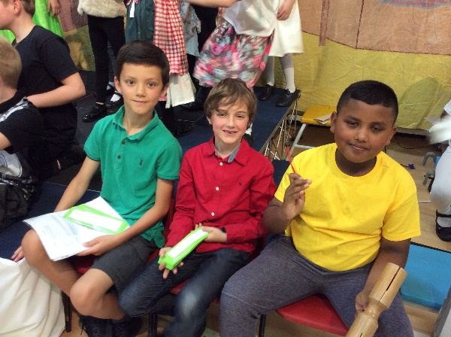
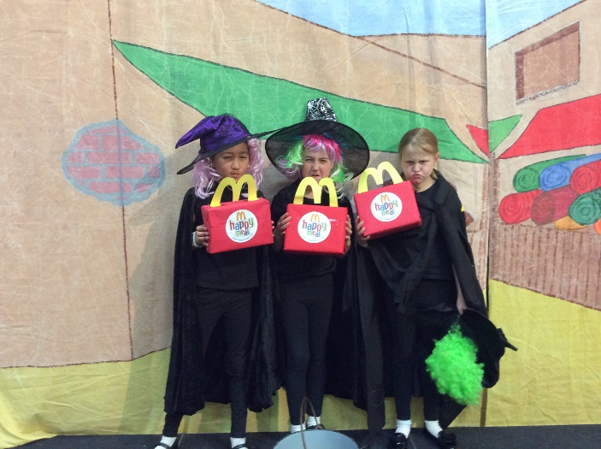
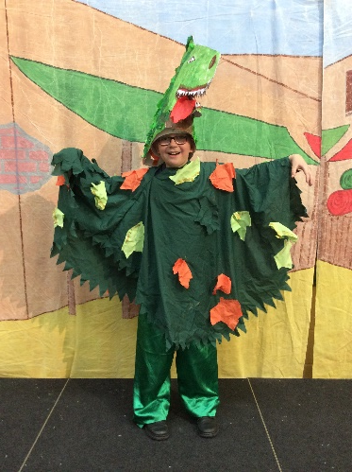
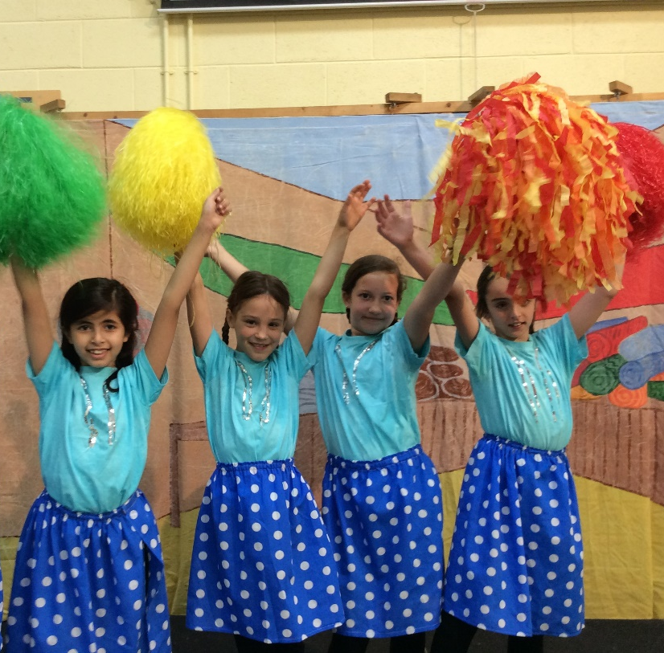
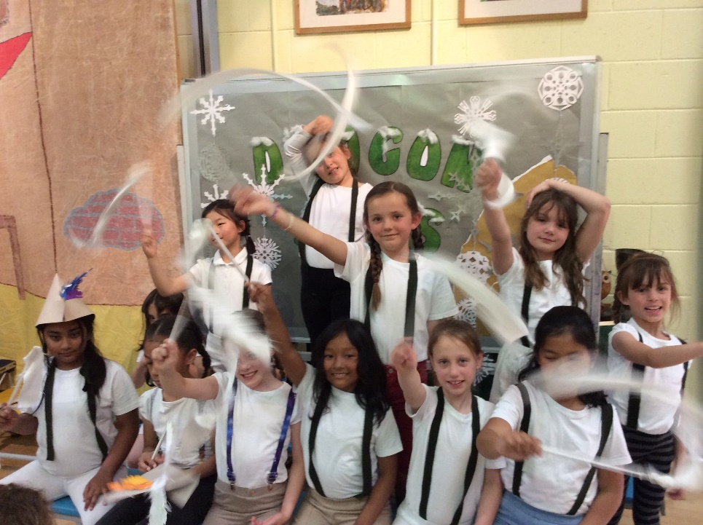
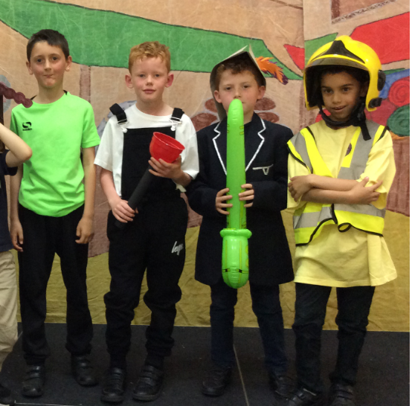
We kicked off our summer term with a wonderful, confident production of ‘Dragon Days’.
With a cast of all-singing, all-dancing superstars!

Slide 3
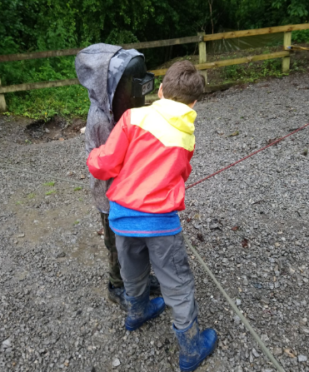
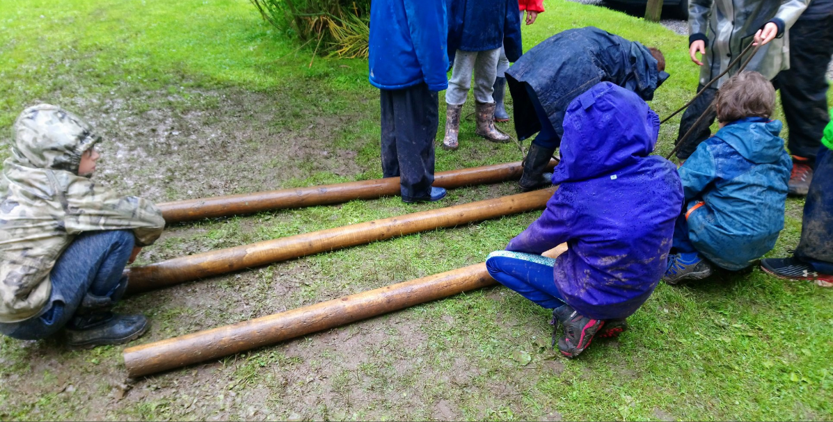
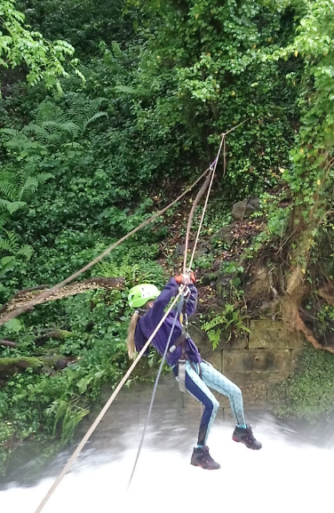
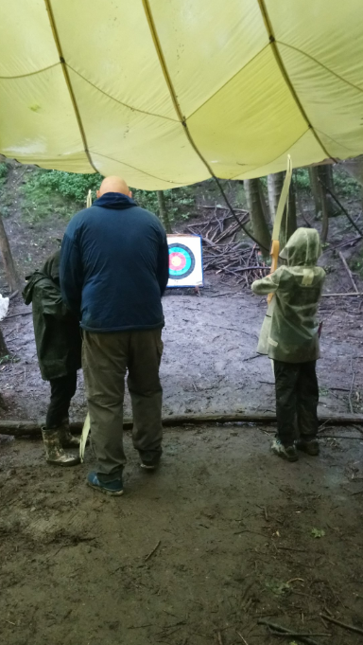
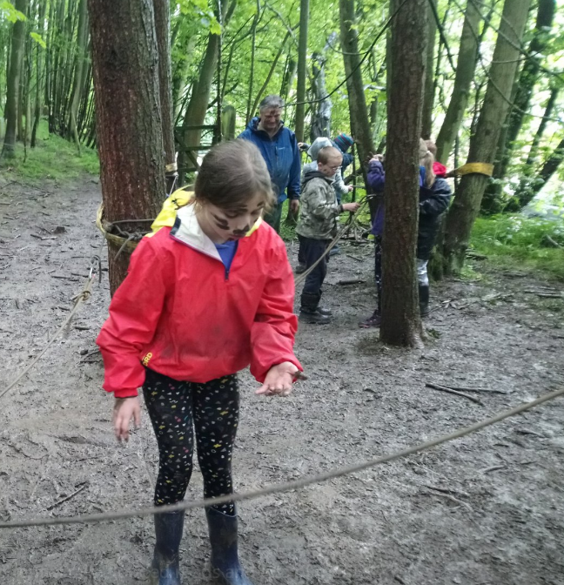
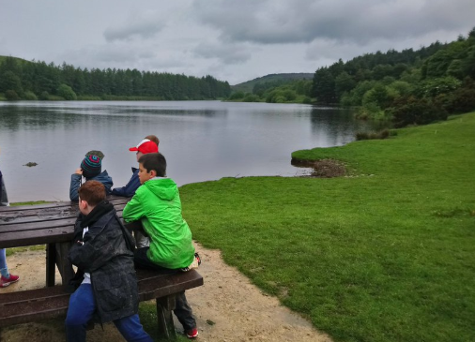
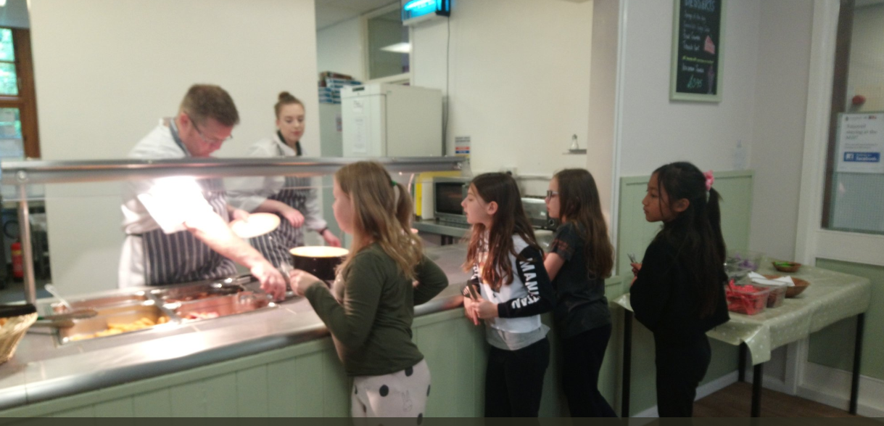
In week 2, our Year 4 pupils went on their very own Incredible Journey. It was incredibly wet and incredibly fun!

Slide 4
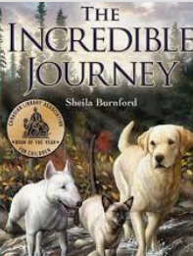
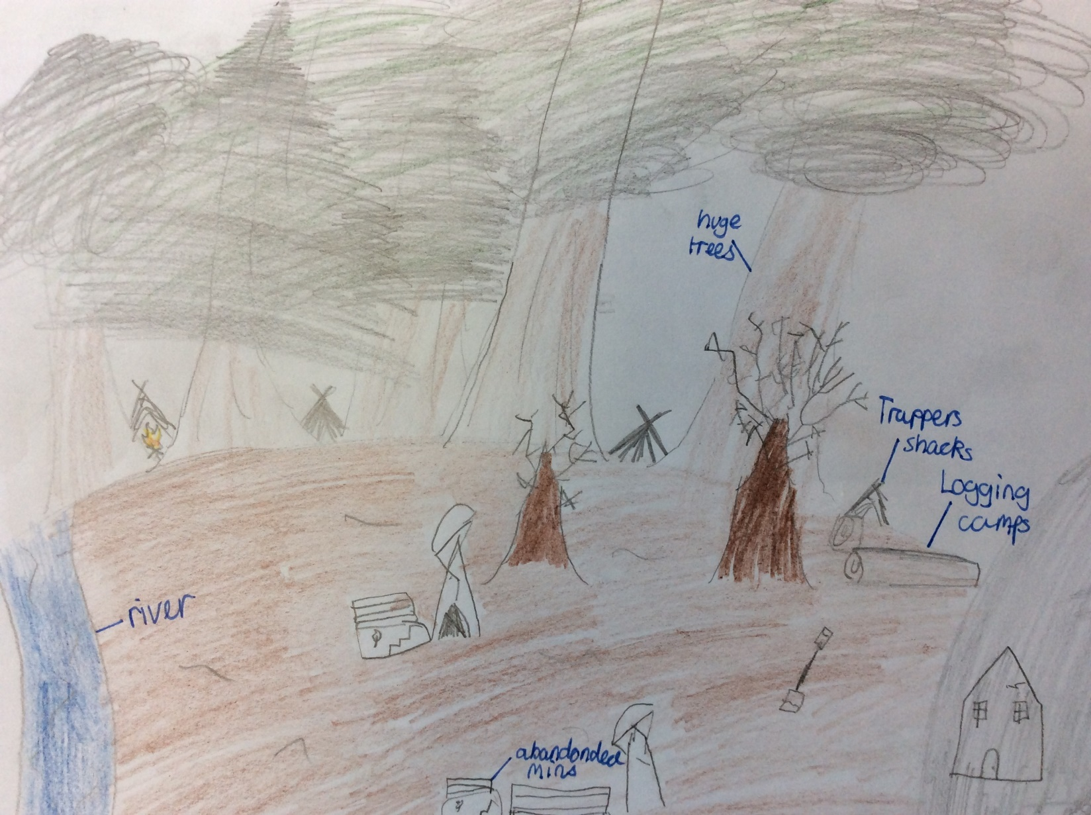
In literacy lessons we have studied the superb descriptive language from the classic ‘The Incredible Journey’ and produced maps of the imagery it created in our imaginations:

Slide 5
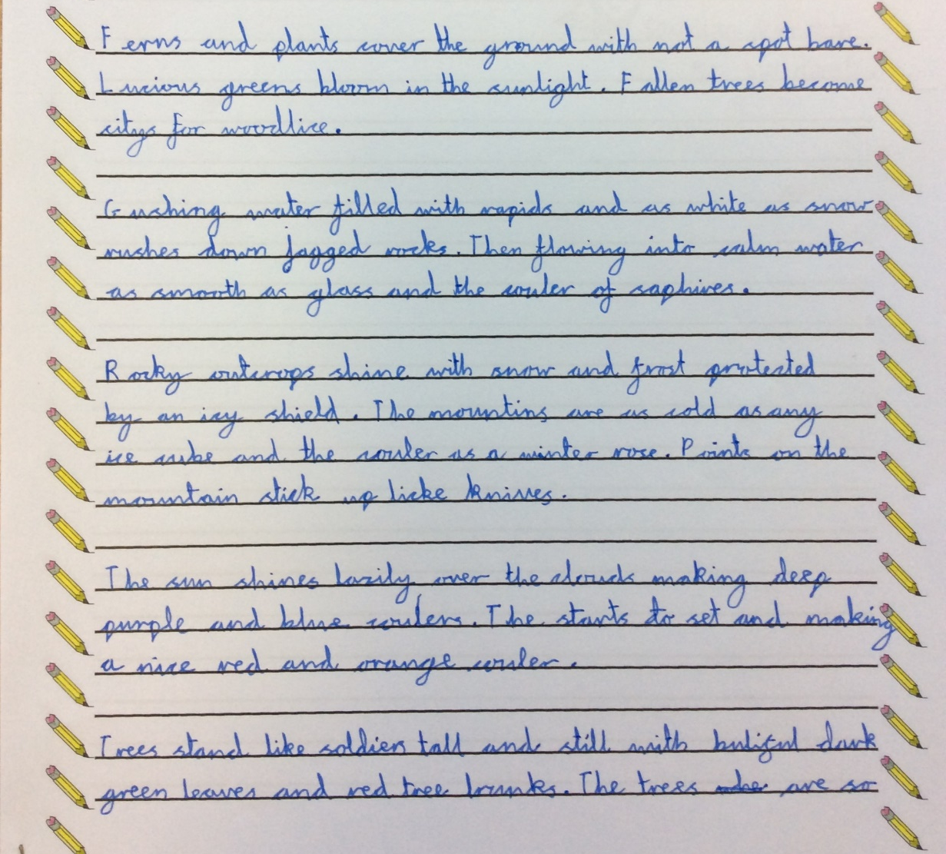
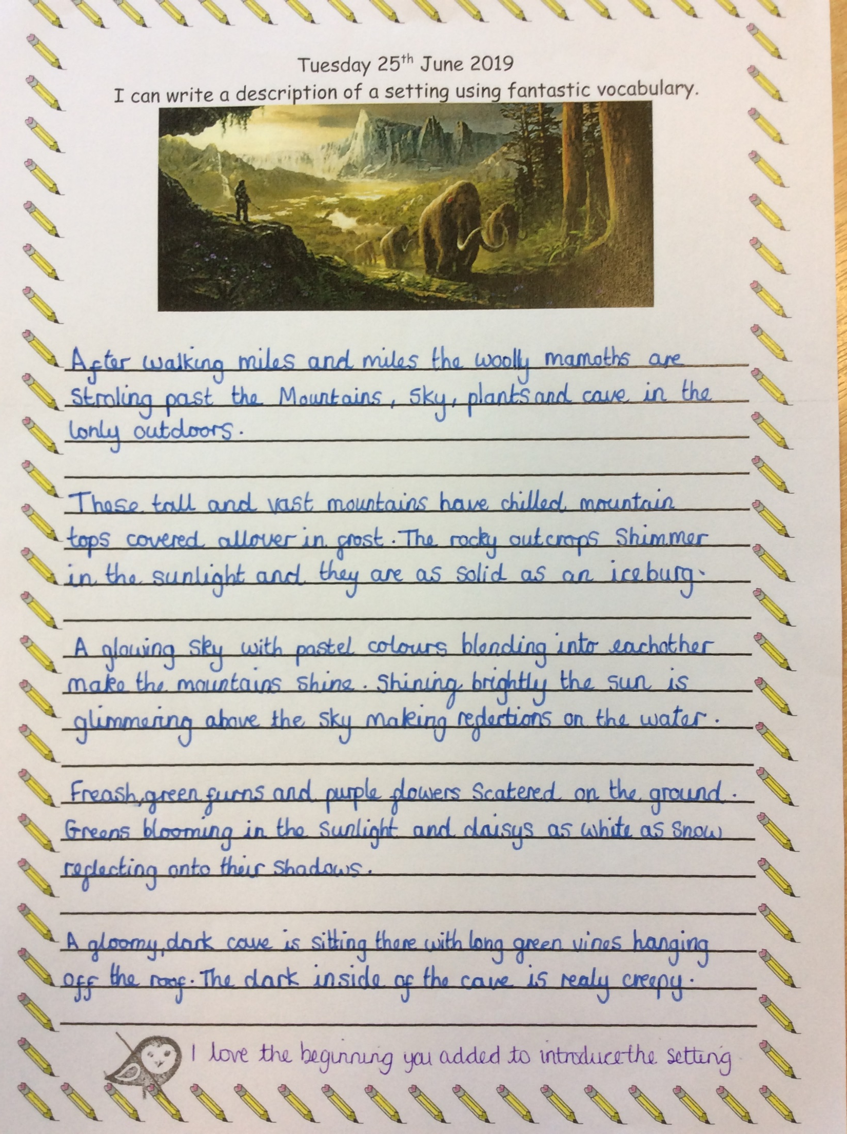
…and wrote some of our own descriptions in a similar style:

Slide 6
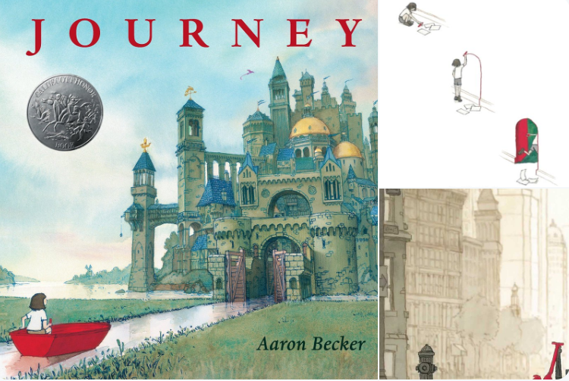
We discovered the most amazing book with NO words. Each page has had us searching for clues and becoming real text detectives. What do you think is behind the door?
I wonder where this purple creature has come from? What does it represent?
Why is everything in shades of grey with just one splash of red?

Slide 7
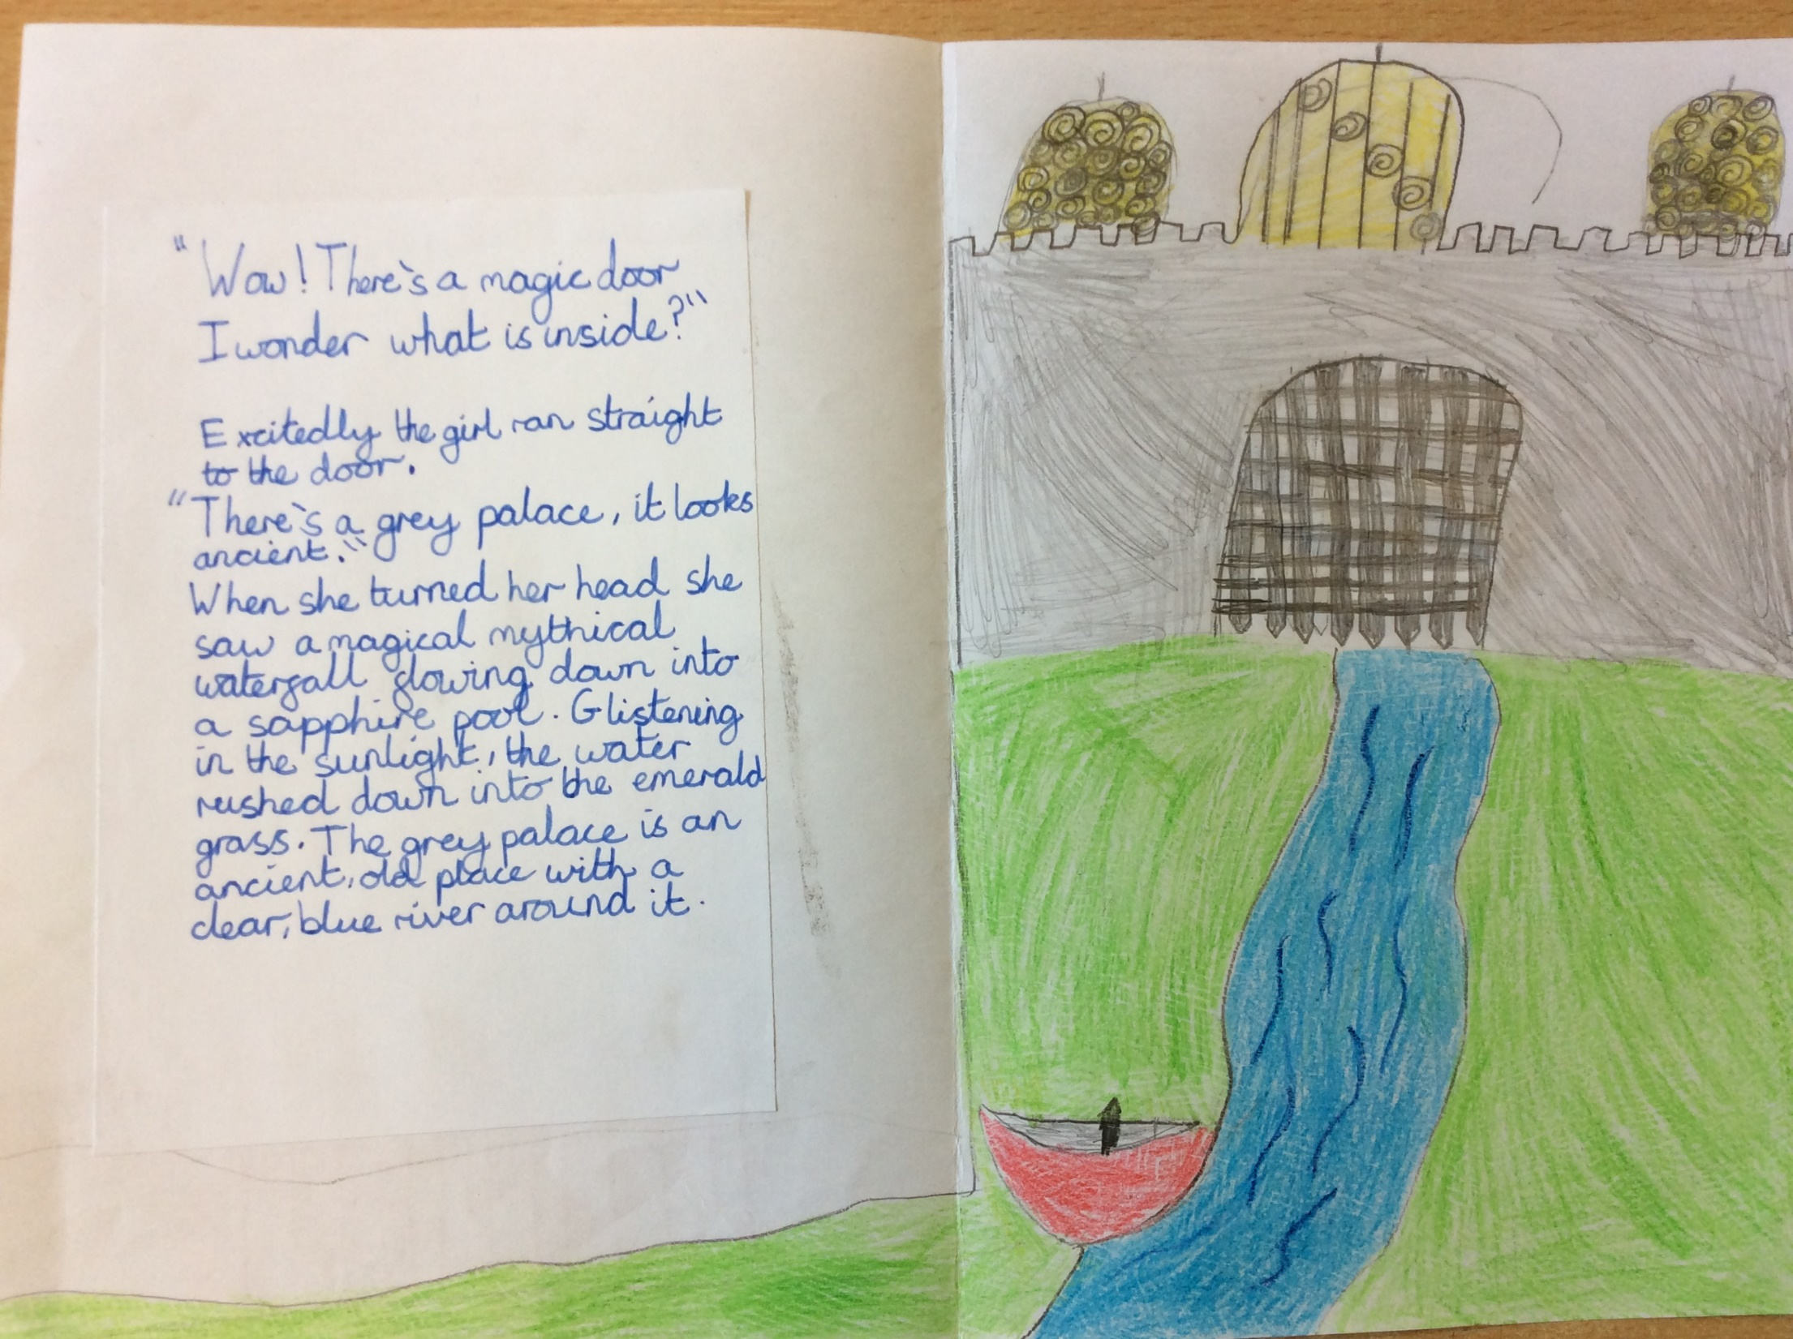
Here is an example of what we thought might be through the door:

Slide 8
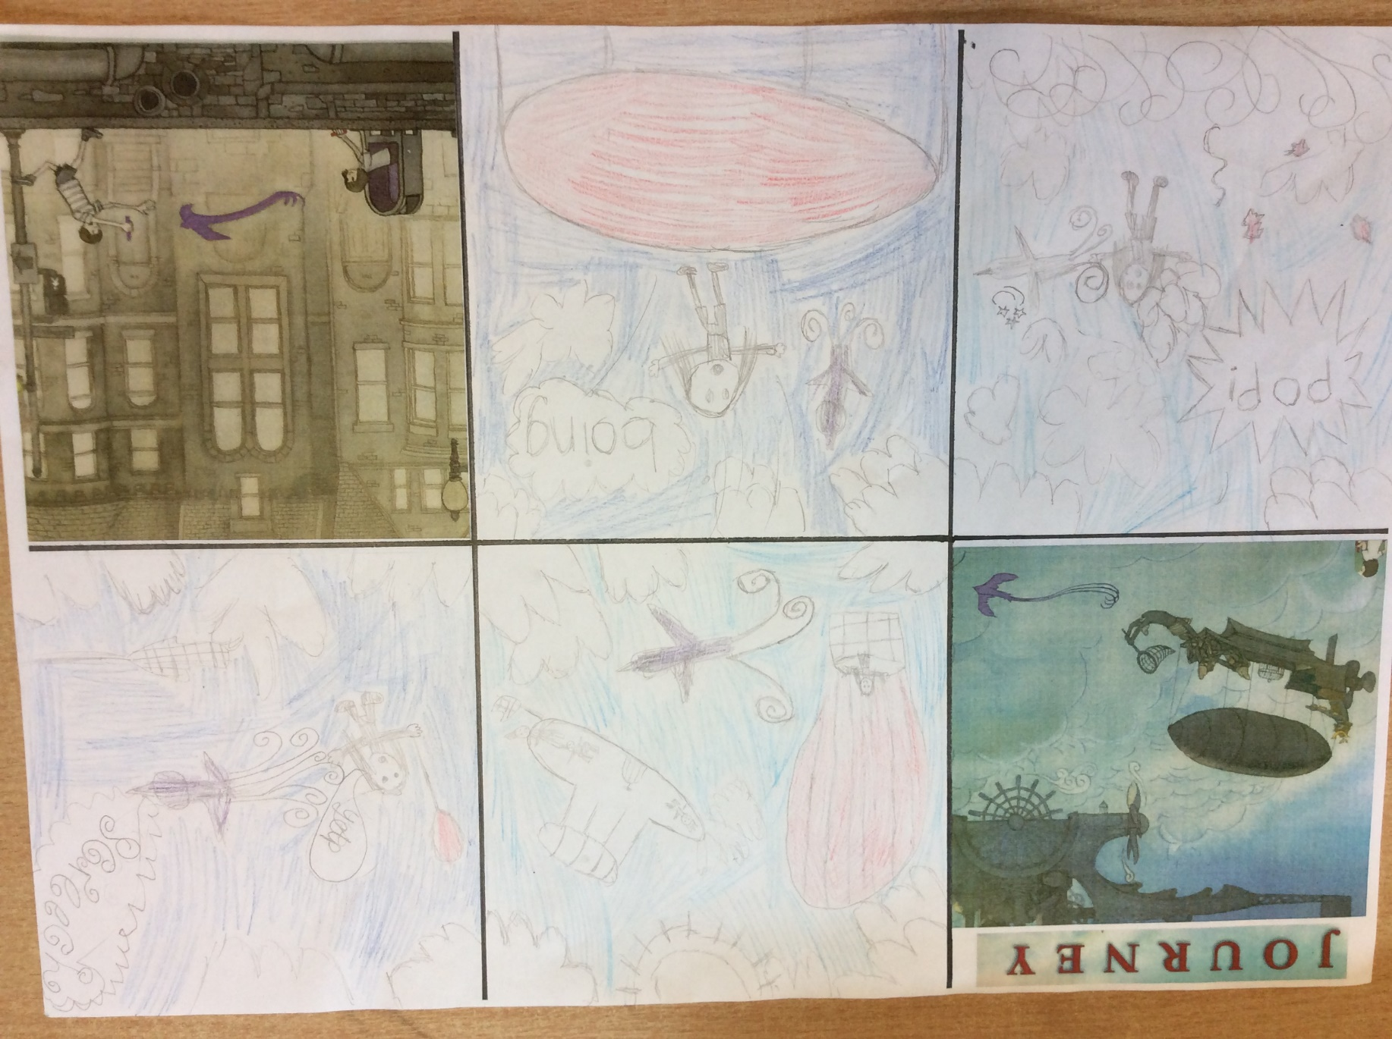
How does it feel to be a picture book author? We found out by creating our own picture book to tell the missing part of the story.

Slide 9
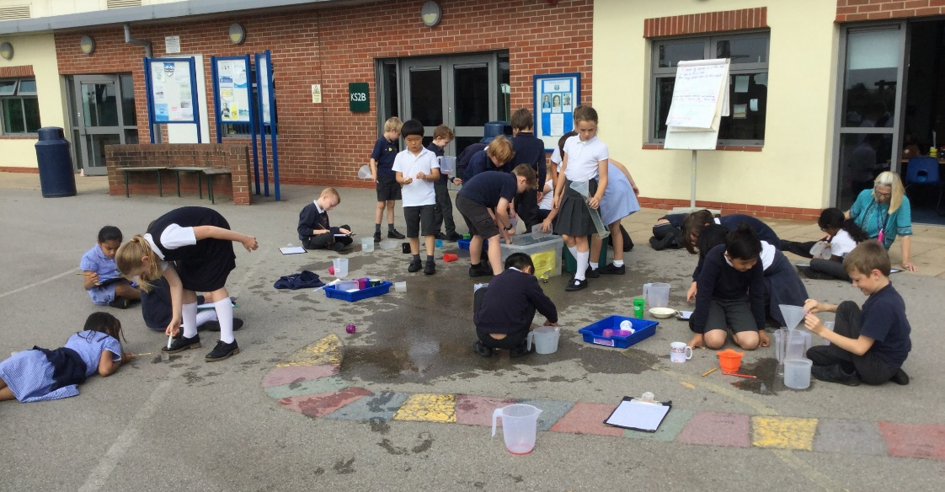
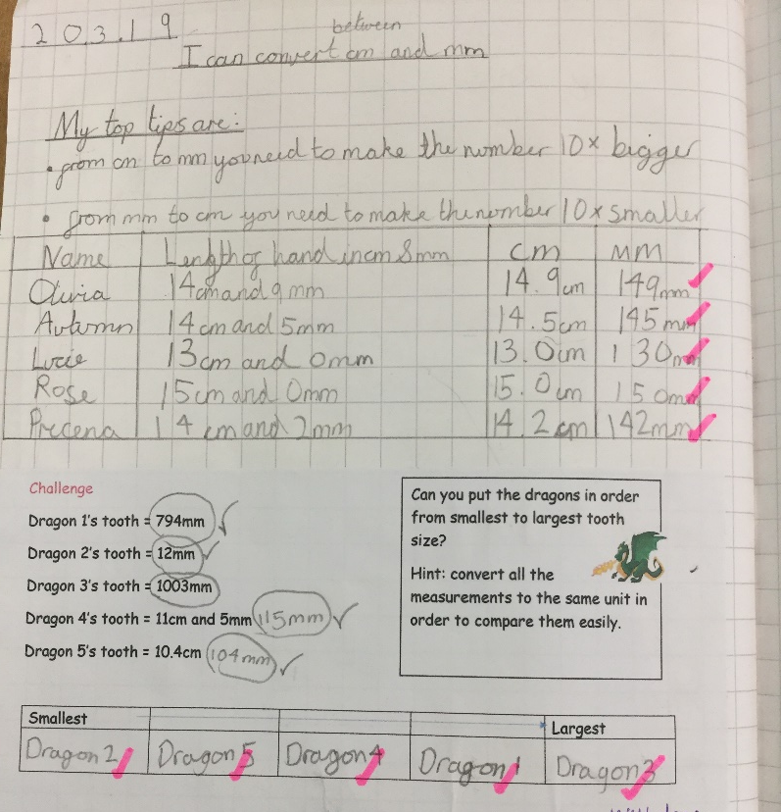
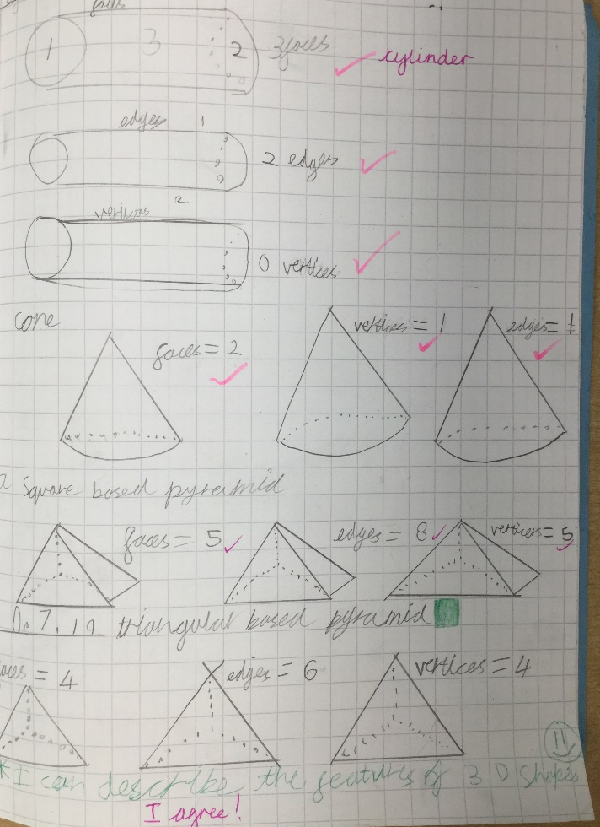
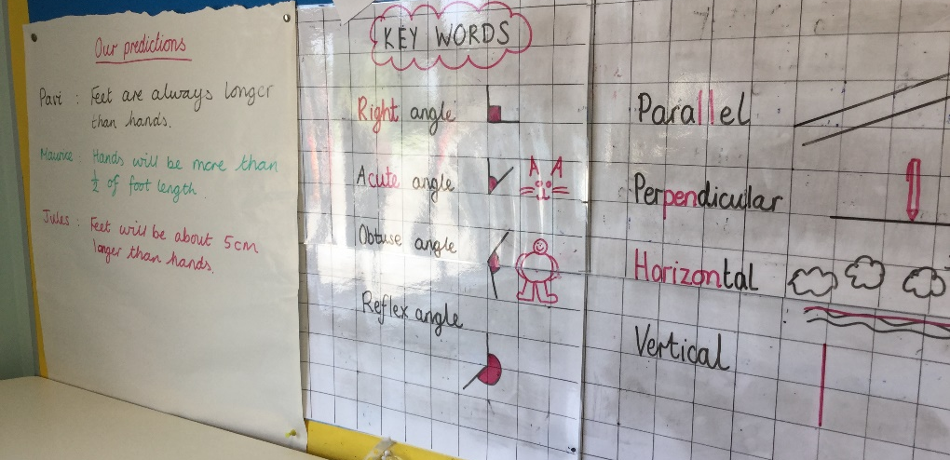
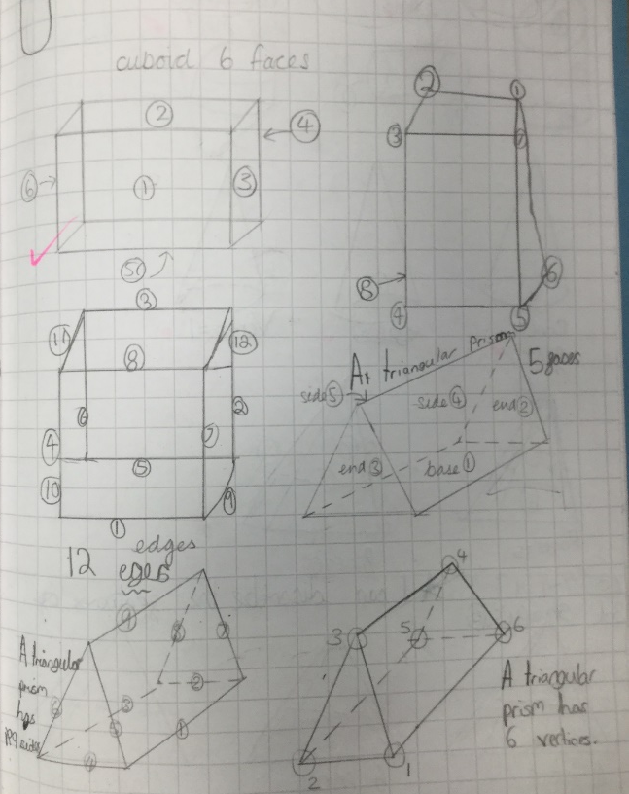
In Year 3 maths, we have been investigating measures…
…and discovering the properties of 3D shapes!

Slide 10
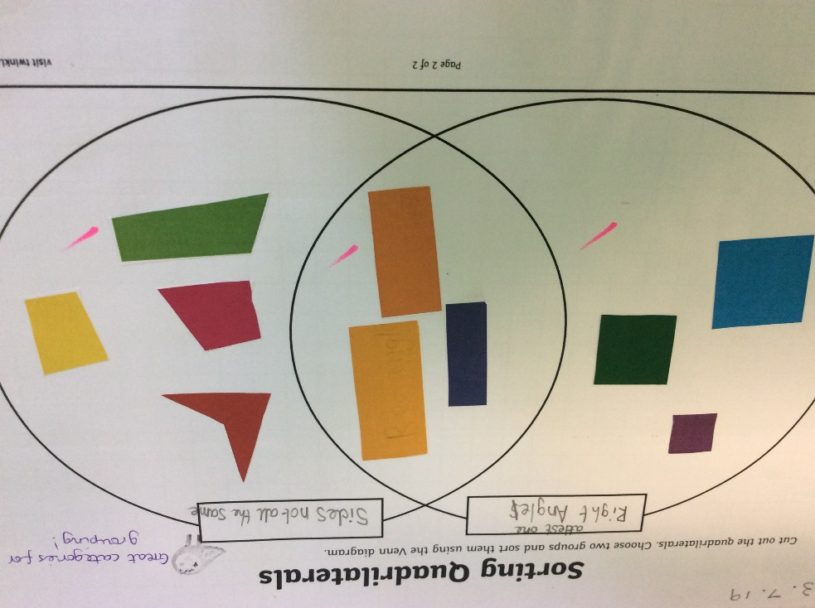
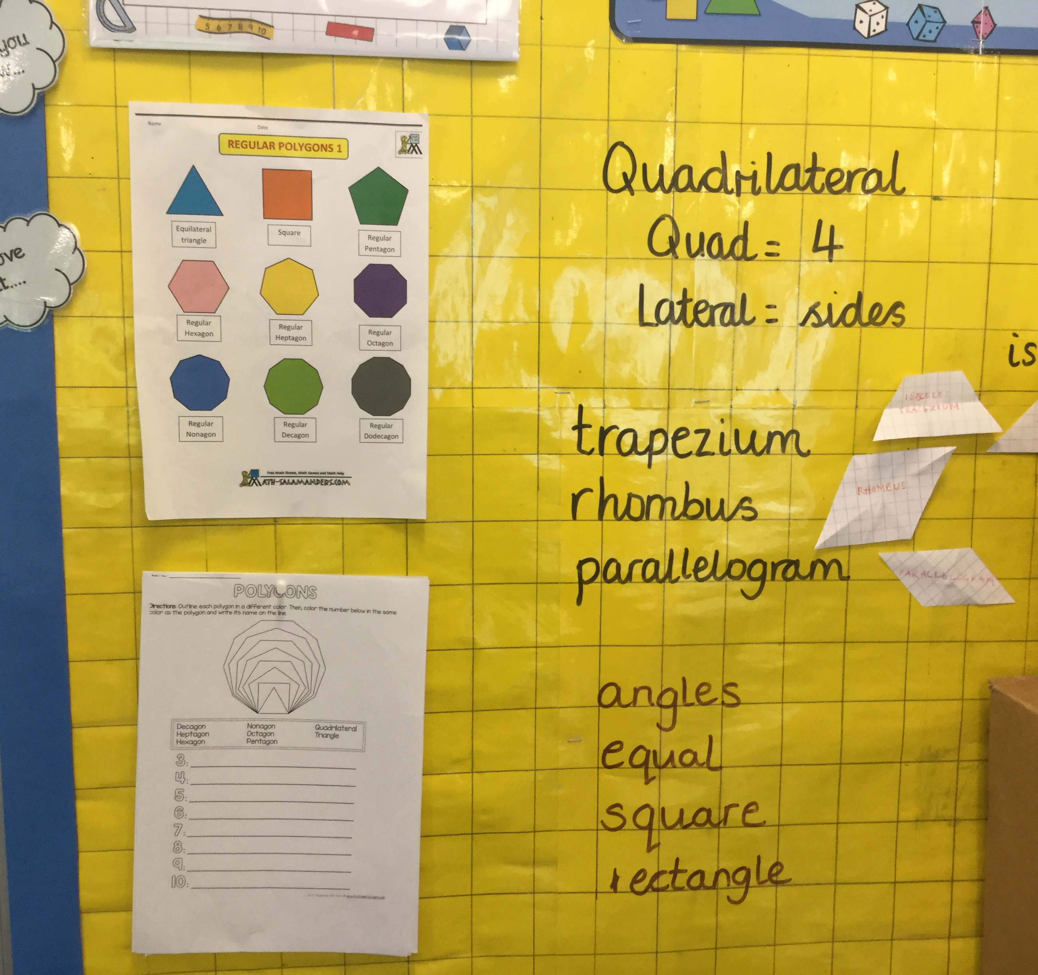
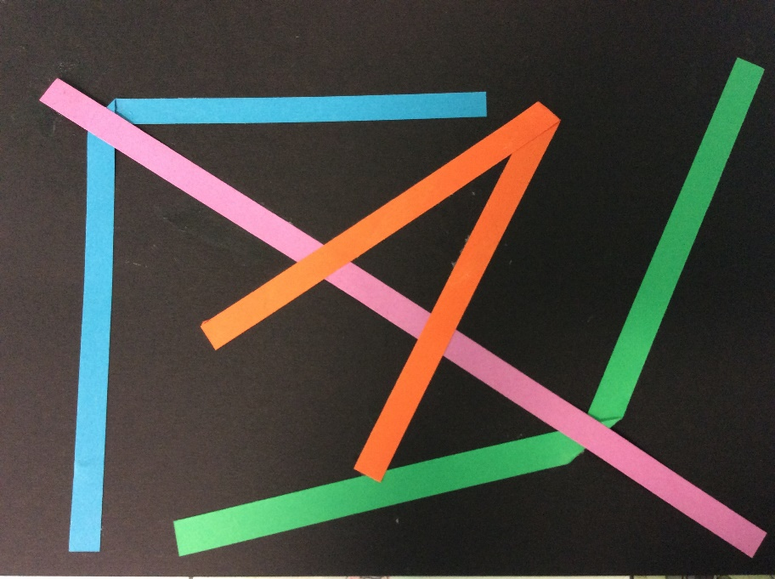
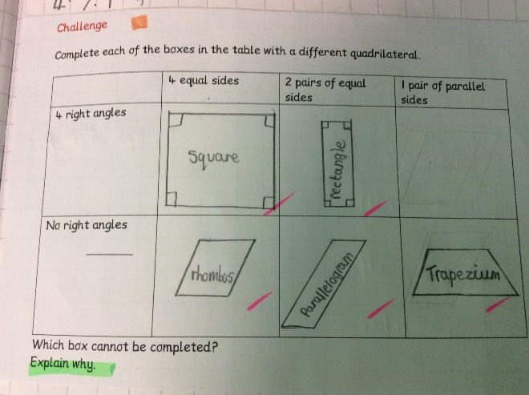
In Year 4 maths, we have been learning about money, time, shape and angles. Look at our fabulous work:
We use mathematical vocabulary to describe quadrilaterals!
Can you see the acute, obtuse and reflex angles on our straight line?
We chose how we wanted to sort these quadrilaterals into two groups. It was harder than it looks!
How would you explain why one of our boxes is empty?

Slide 11
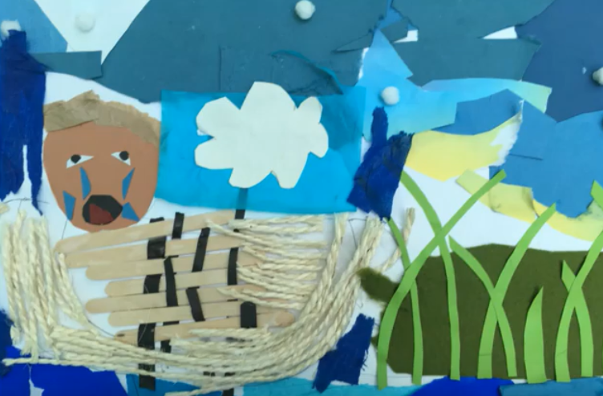
YOYO worked with us in a CREATE session. We retold the story of Moses, in 3 parts, through collage and created our own picture book to be narrated. We hope you like it!
http://www.yoyotrust.org.uk/create
In RE lessons we have been discovering some amazing journeys others have travelled. We were told tales of pilgrimages and shared stories of our own life journeys.

Slide 12
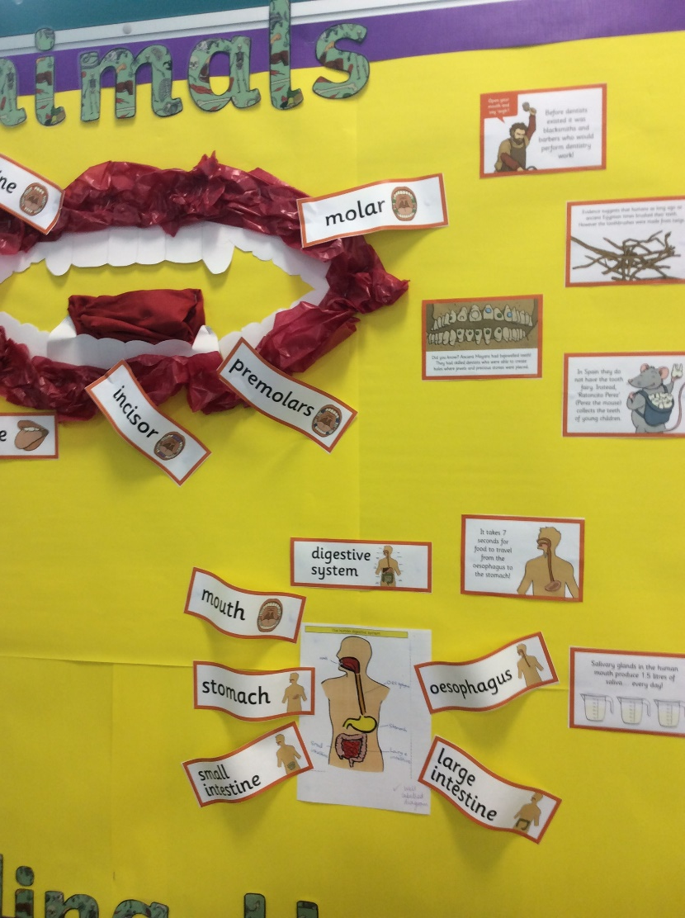
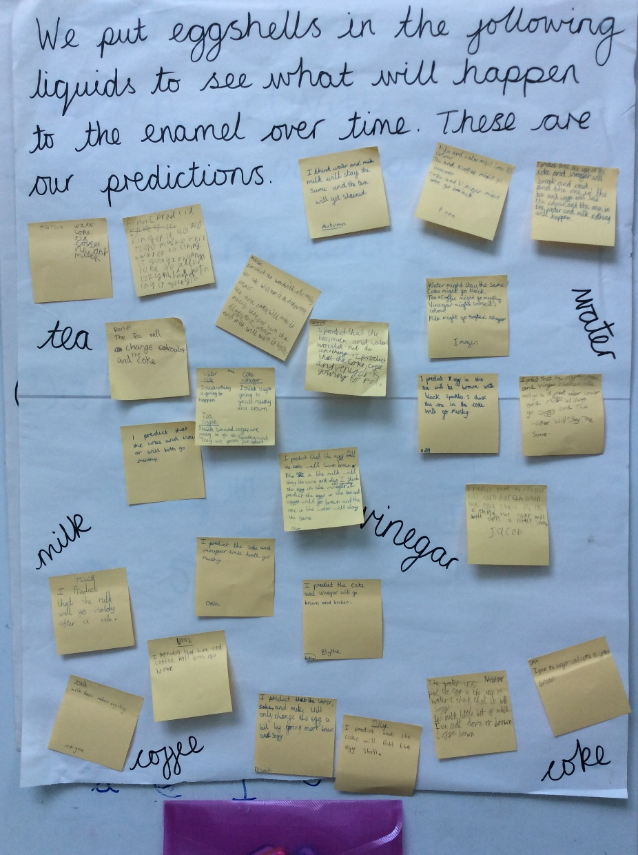
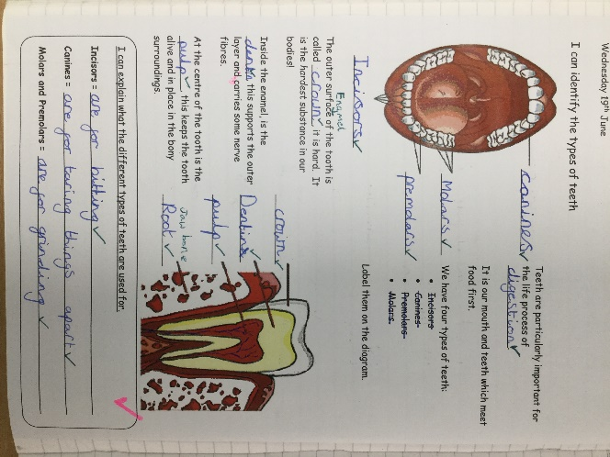
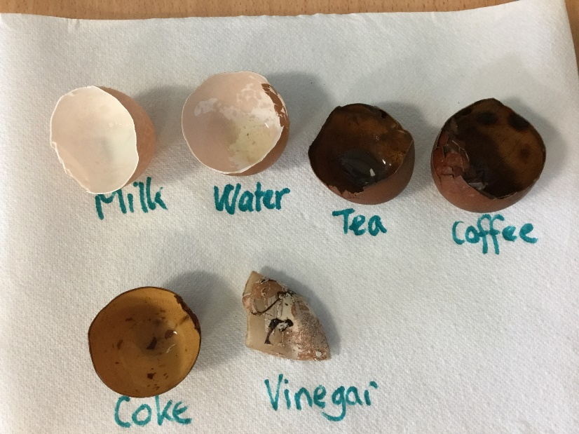
In science lessons we have been learning about living things. Humans and animals are incredible!
What happens to our teeth when we drink different beverages?
Look at the effect these drinks would have on our teeth enamel!

Slide 13
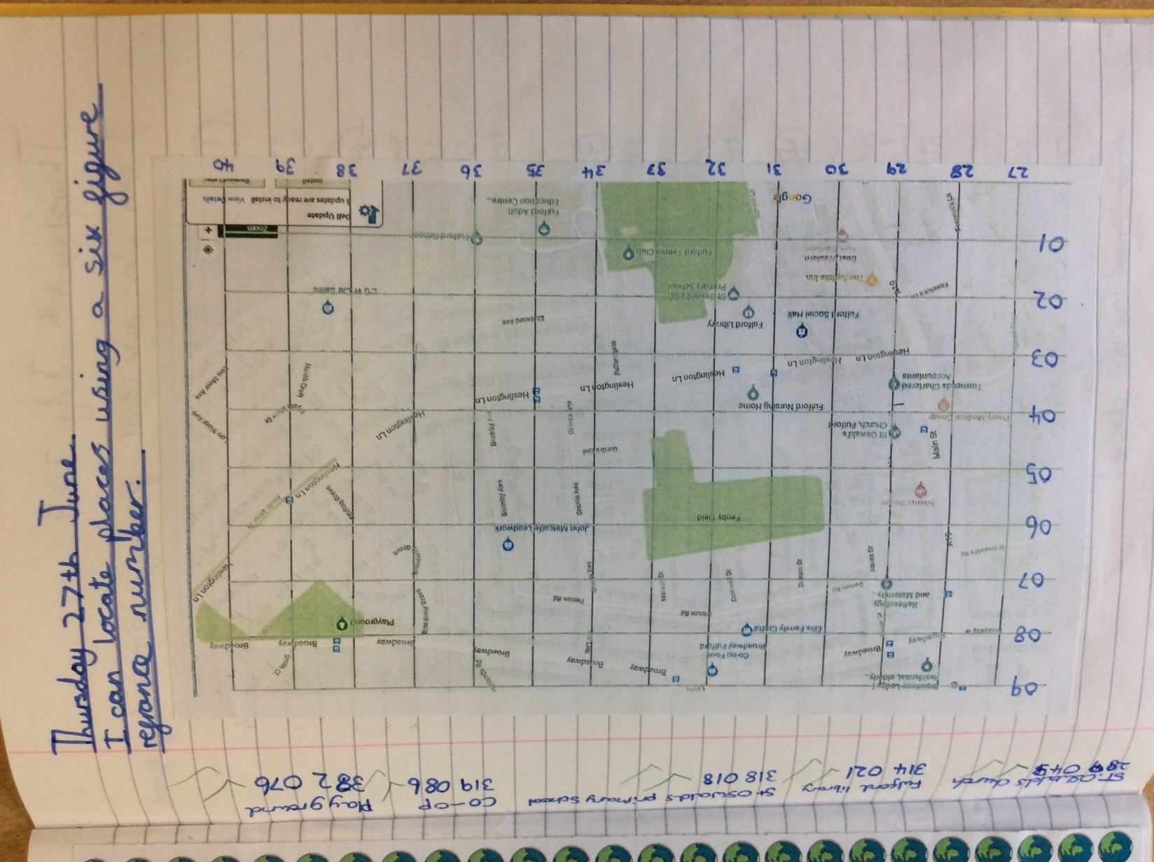
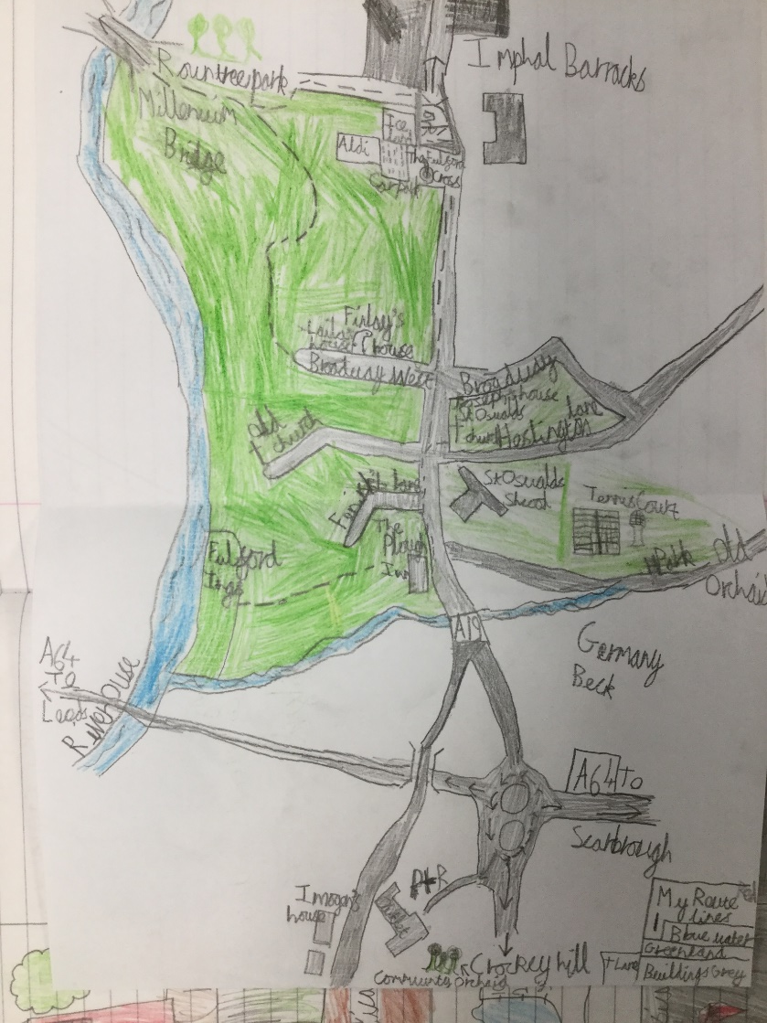
In topic lessons, we have been learning how to read maps and plan journeys. Grid references have helped us to describe the location of different human and physical features of Fulford.
I

Slide 14
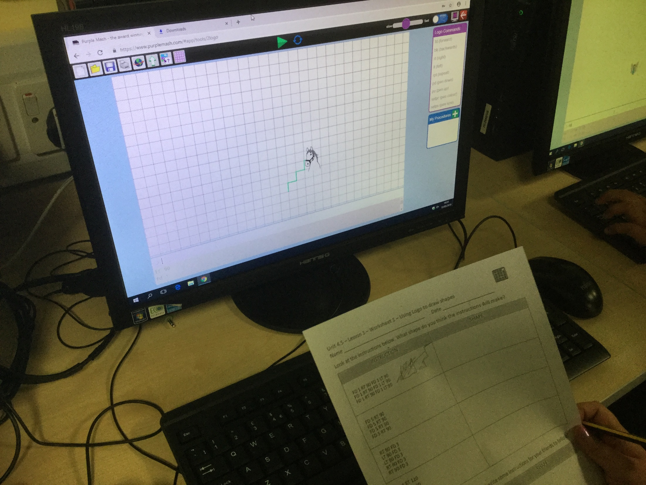
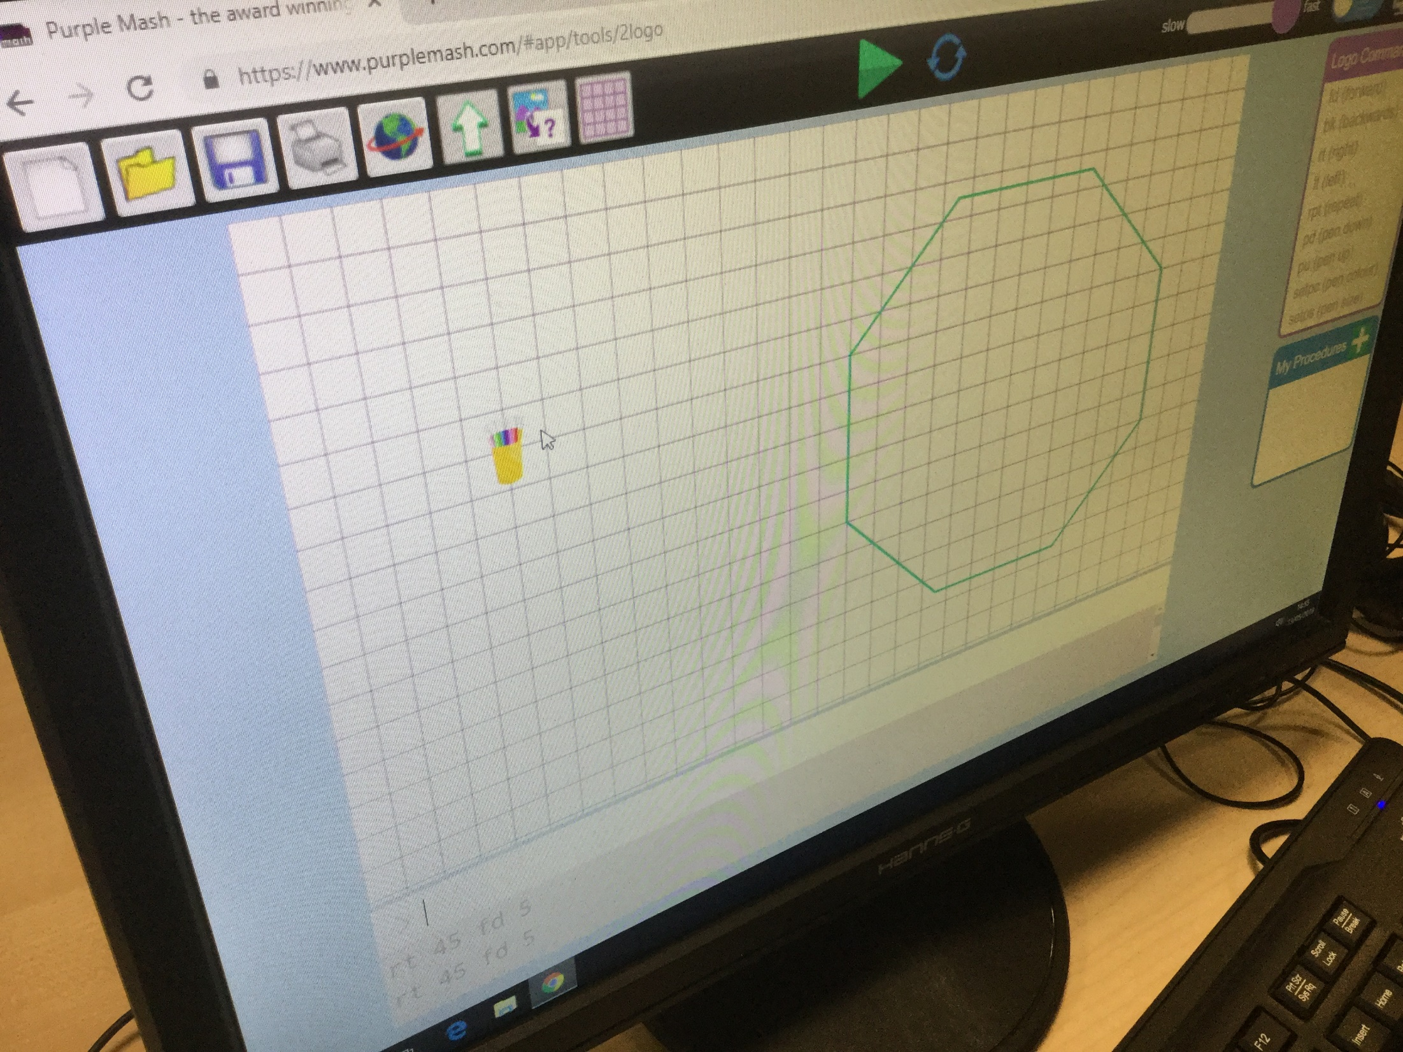
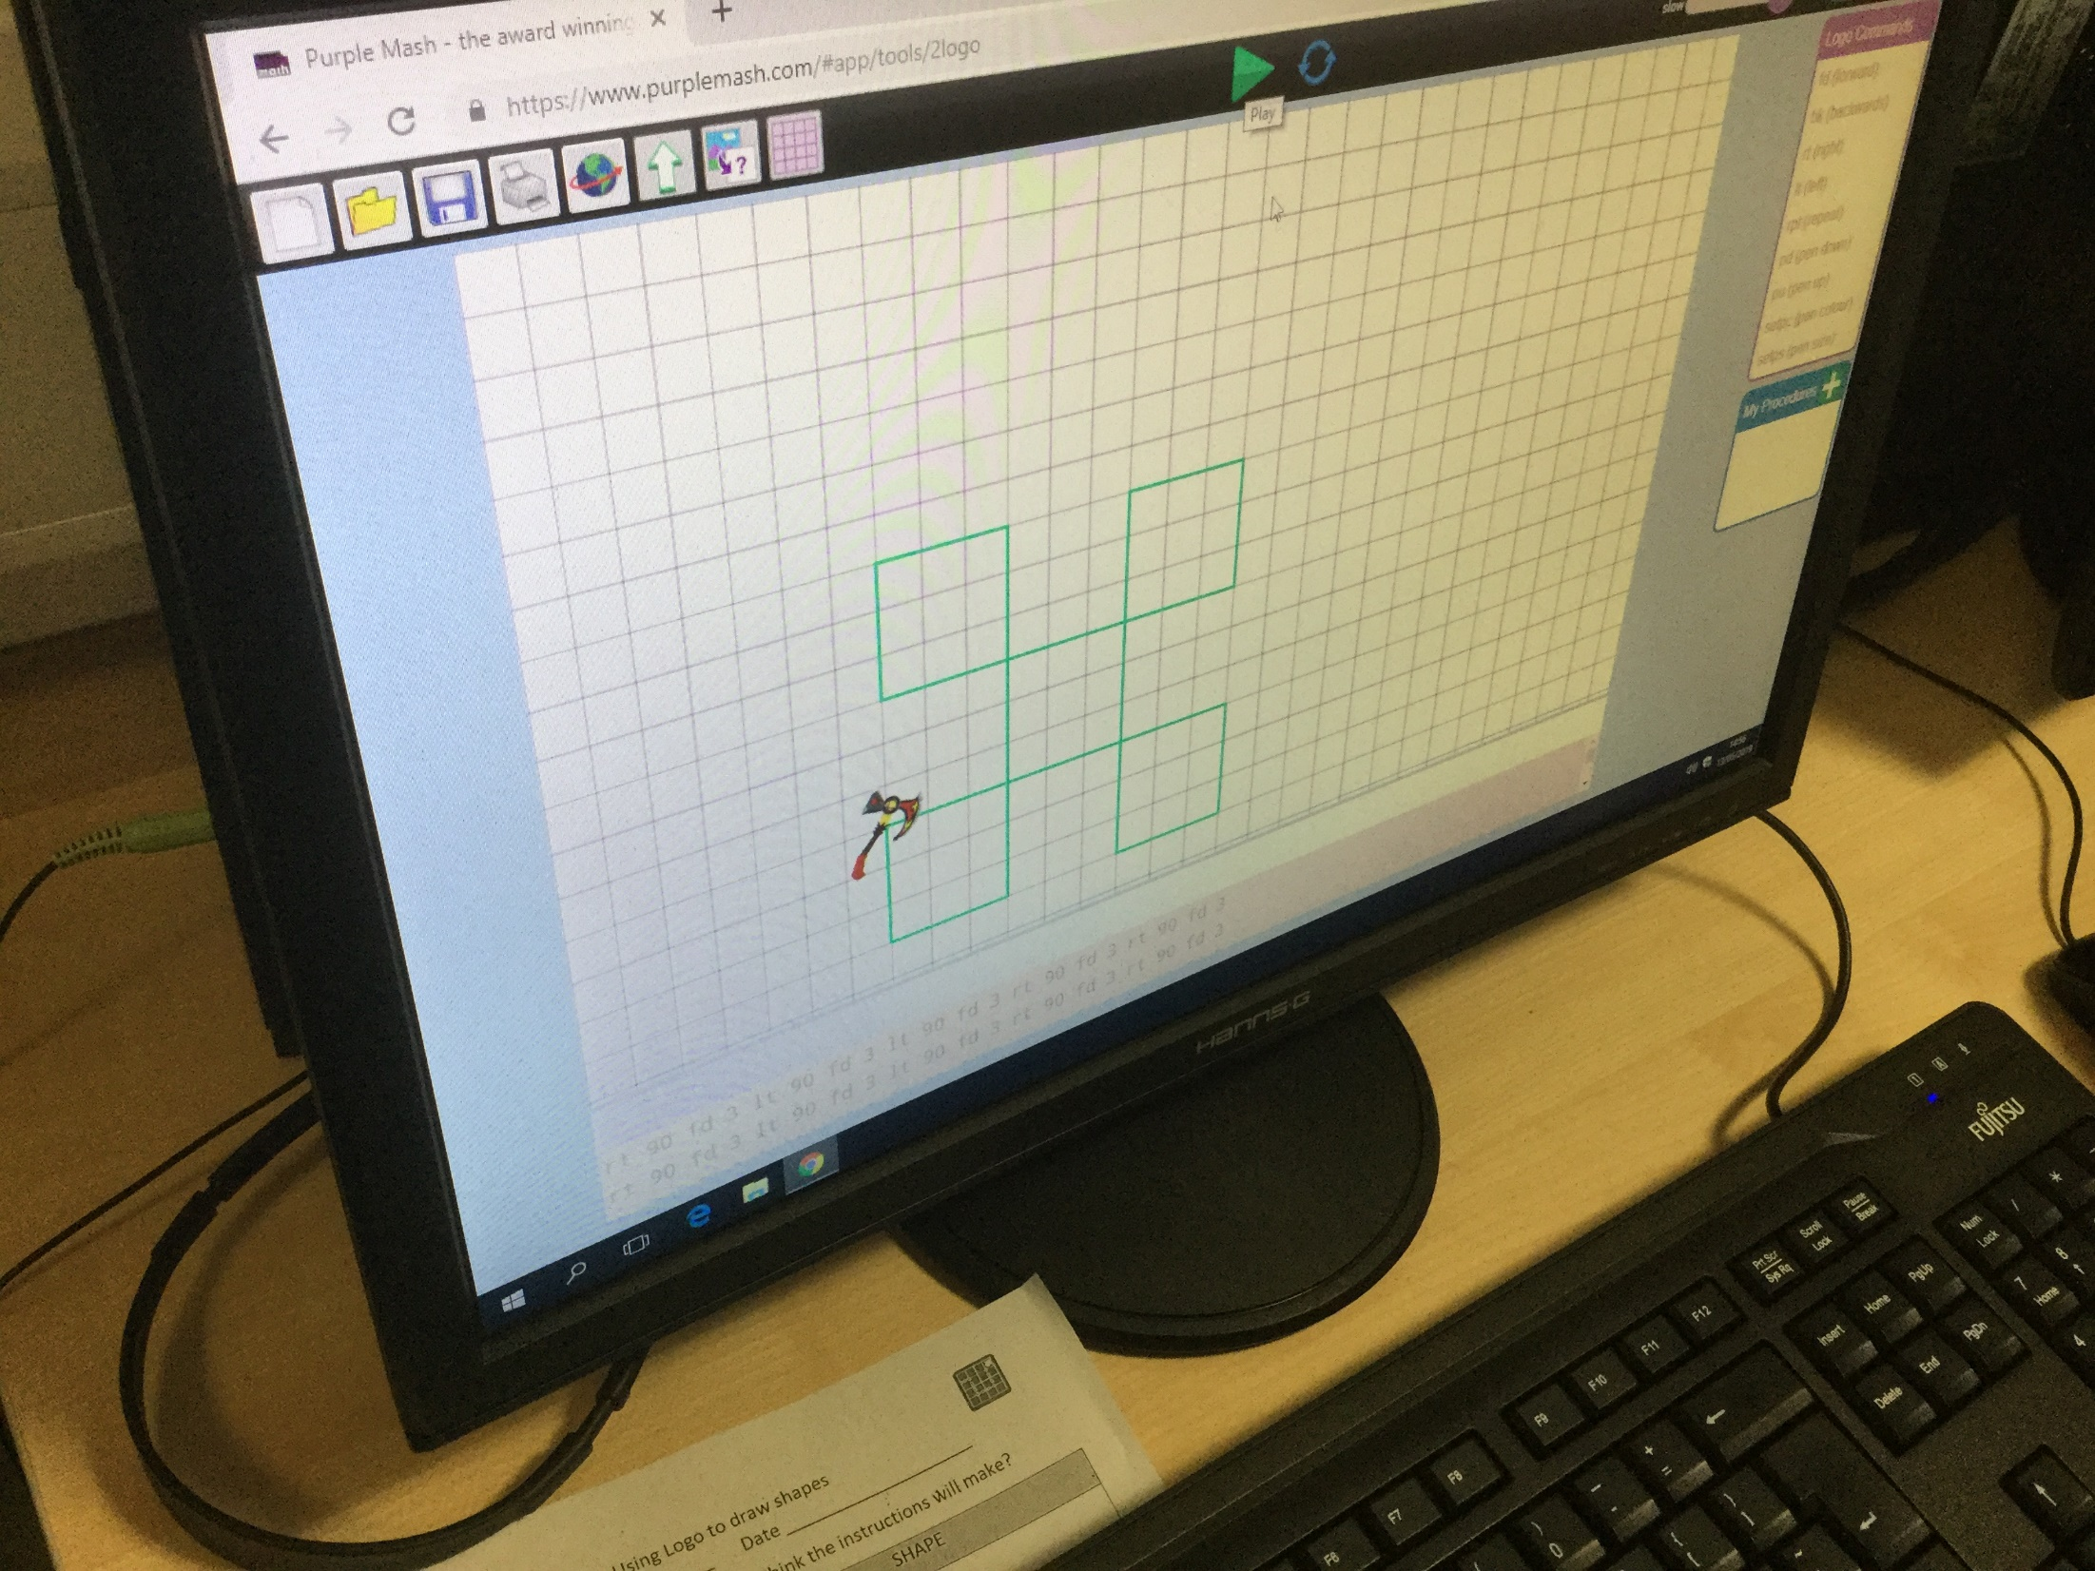
We have been learning how to programme a turtle in our computing lessons this term. Each lesson has challenged us to use technical vocabulary and clear instructions. Our progress has been great!
1. Following instructions to make a shape.
2. Programming our own shapes.
3. Using the repeat command to make patterns!

Slide 15
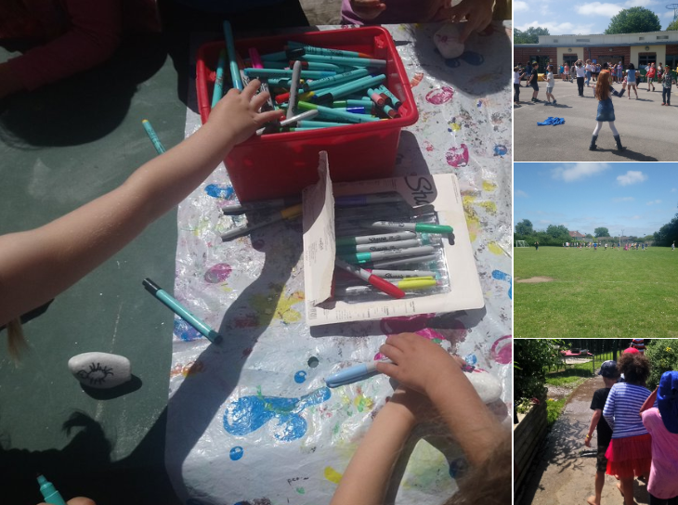
Mrs Bland treated all the children at St Oswald’s to a super seaside day to say thank you for being such exceptional pupils. It was fantastic FUN!
I liked decorating my seaside pebble – I love being creative!
The water area was my favourite because we got to splash about and get very wet!
I loved the ice-cream van and the fish and chips too!

Slide 16
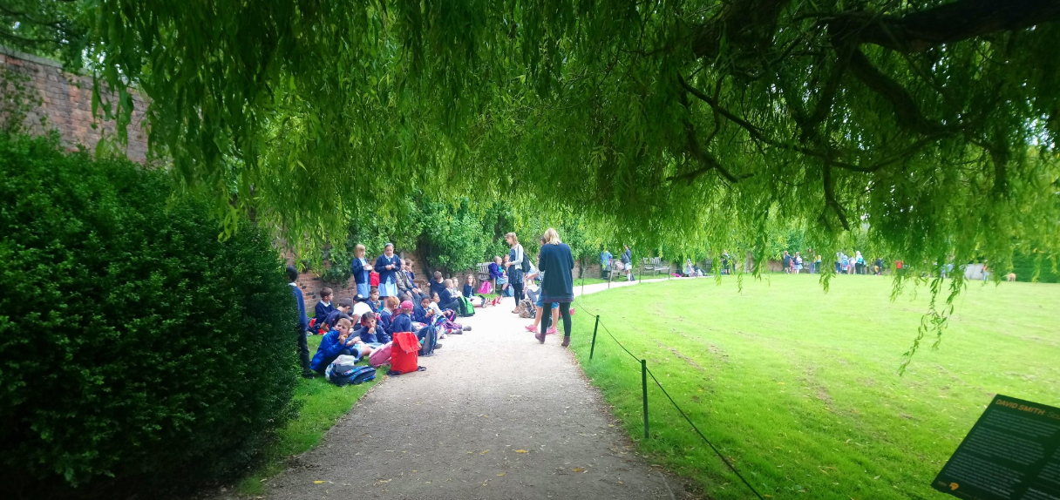
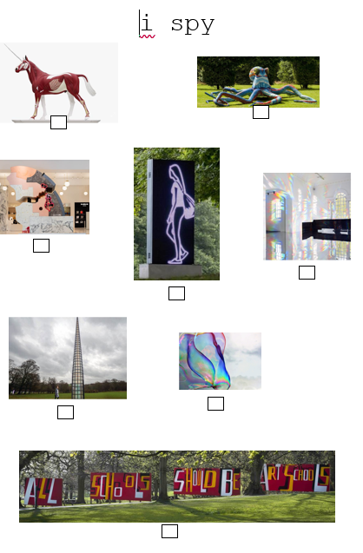
Year 3 & 4 pupils visited the Yorkshire Sculpture Park as a ‘Fabulous Finish’ to our topic. We studied maps of the park before we visited and created our own ‘i-spy’ activity sheet.
Snacks then sculpture-spotting!

Slide 17
Thank you for sharing our learning journey with us.
We wish you all a happy summer holiday!
I

