Slide 1
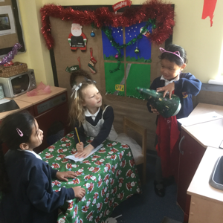
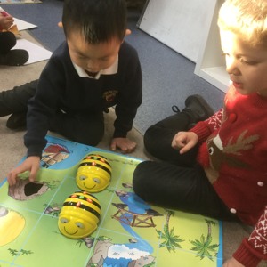
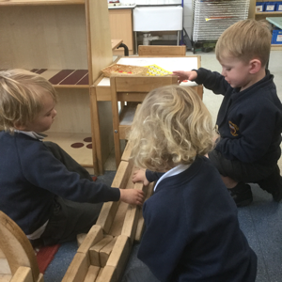
Personal Social and Emotional Development
We are learning to negotiate, take turns and make friends. We are becoming more and more confident and independent in our learning and about our abilities. We talk about our rules and how we follow them. We are learning to talk about our school values in class collective worship and reflection time.

Slide 2
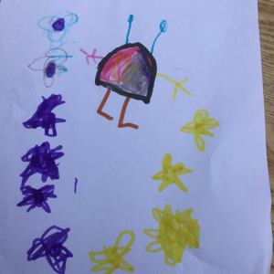
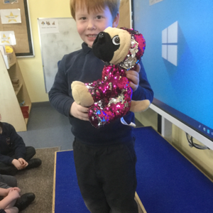
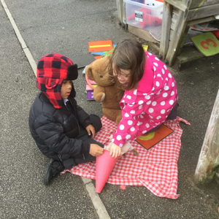
Communication and Language
We are learning to speak with confidence to lots of different people, to listen in a range of situations and to follow instructions. We have read ‘Whatever Next’ this term.
We have talked about space and thought about aliens, reading lots of space stories and information books
We practise our speaking and listening skills every week with ‘show and tell’ in our classes.
We acted out the story of Whatever Next in our play

Slide 3
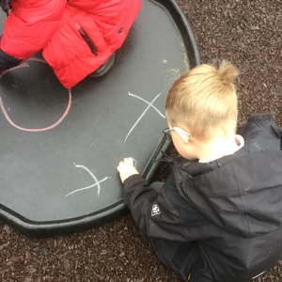
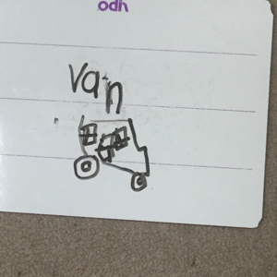
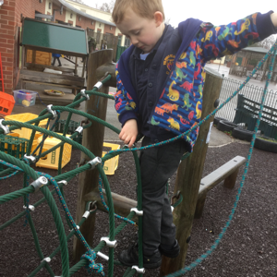
Physical Development
We continue to develop our physical skills with tools, equipment and mark-making. We enjoy a weekly PE lesson and we dress and undress by ourselves.

Slide 4
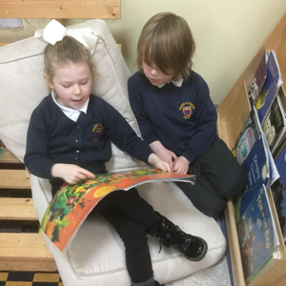
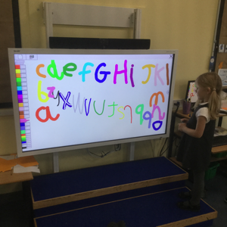
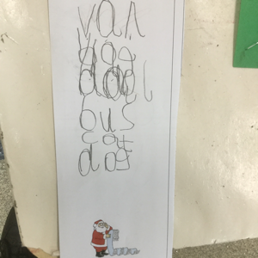
Literacy
We are starting to read simple words and sentences, and to know all of the letter names and sounds. We are applying this when playing. We are learning different purposes for writing, such as a Christmas list. We love exploring books and stories in the story corner or outside. We have class story time several times a day.

Slide 5
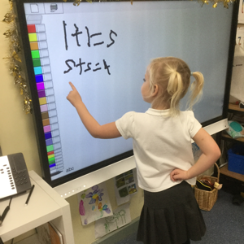
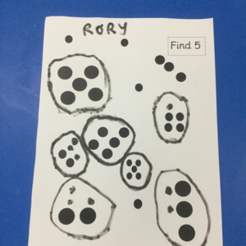
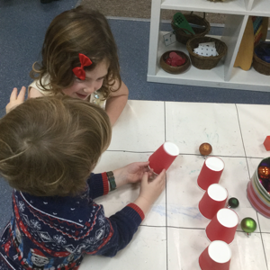
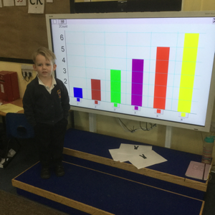
Maths
We are learning about numbers in depth – how to make them, represent them in different ways, talk about them. We love watching Numberblocks and we explore numbers and shapes in our play every day.

Slide 6
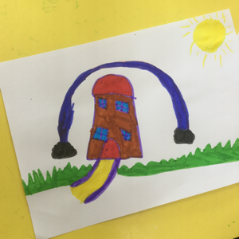
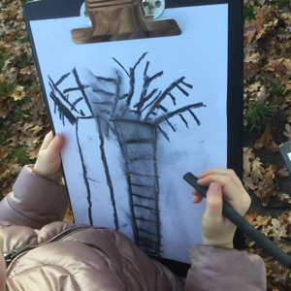
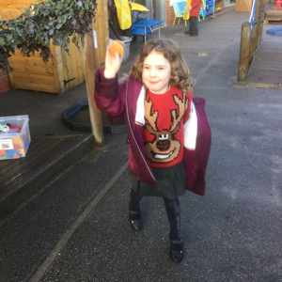
Expressive Arts and Design
We explore lots of different media and materials and express our own feelings and ideas through them. We have been learning songs for Christmas Nativity and love to explore instruments in the classroom and outside.

Slide 7
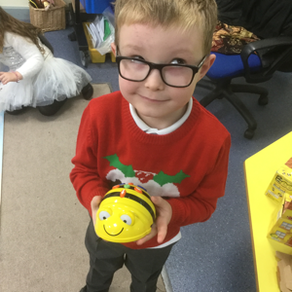
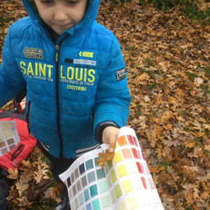
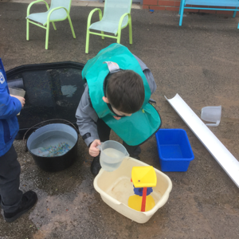
Understanding the World
We visit the school wild area every week and learn about our envinronment and observe plants and animals. We explore and talk about lots of materials, including sand, water and mud, every day. We’ve talked about the festival of Diwali this half term and have been learning the story of Christmas. We have learned to programme Beebots and use the smartboard every day.

