Slide 1
Let there be light
Year 3 and 4
Autumn Term 2

Slide 2
We kicked off our literacy learning this half term by visiting the theatre! The Grand Opera House in York was showing ‘Tom Gates Live!’ and as Liz Pichon is one of our most popular authors in Year 3/4, we just had to see the show!

Slide 3
The show was amazing and so when we returned to school, we decided we would write letters to our favourite authors. Many of us chose Liz Pichon! We studied the features of a letter and planned, drafted and published our own. We sent them by email to the authors and some of us have been lucky enough to receive replies!

Slide 4
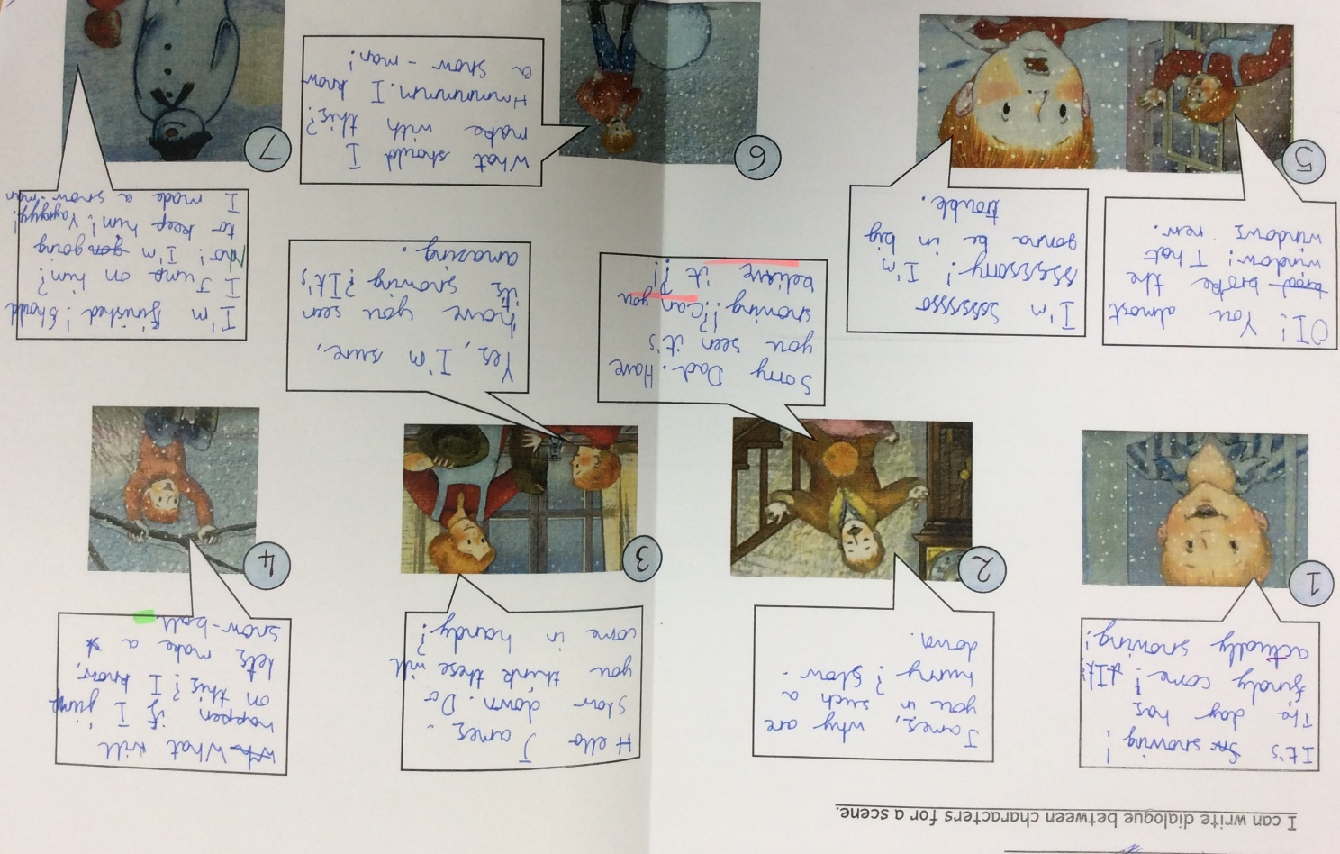
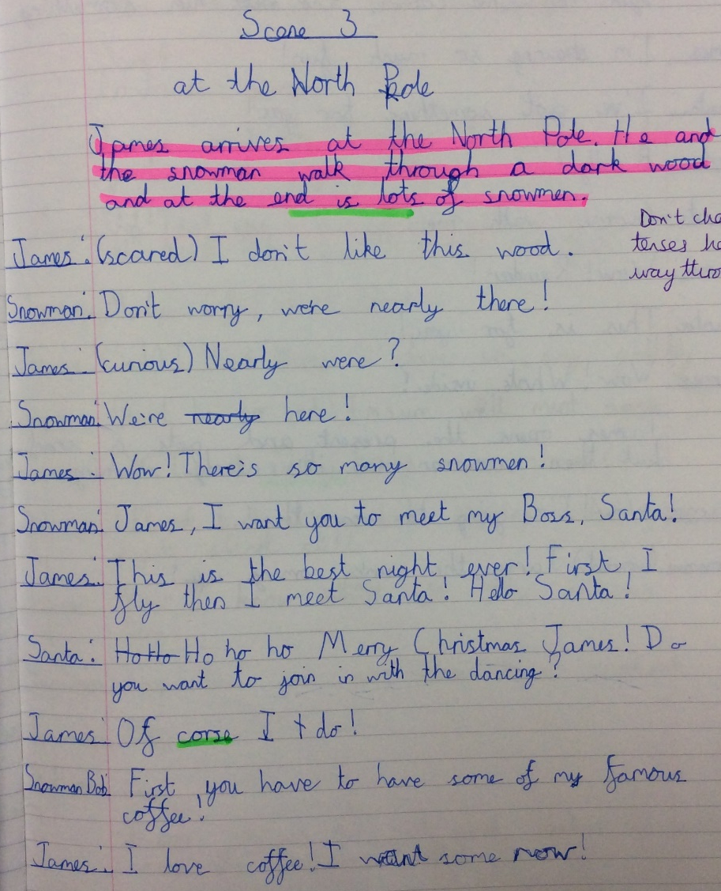
Our next challenge in literacy was to write a play script. We have learned lots about dialogue and how to write it in different forms.
The best part was performing our scenes to the rest of the class!

Slide 5
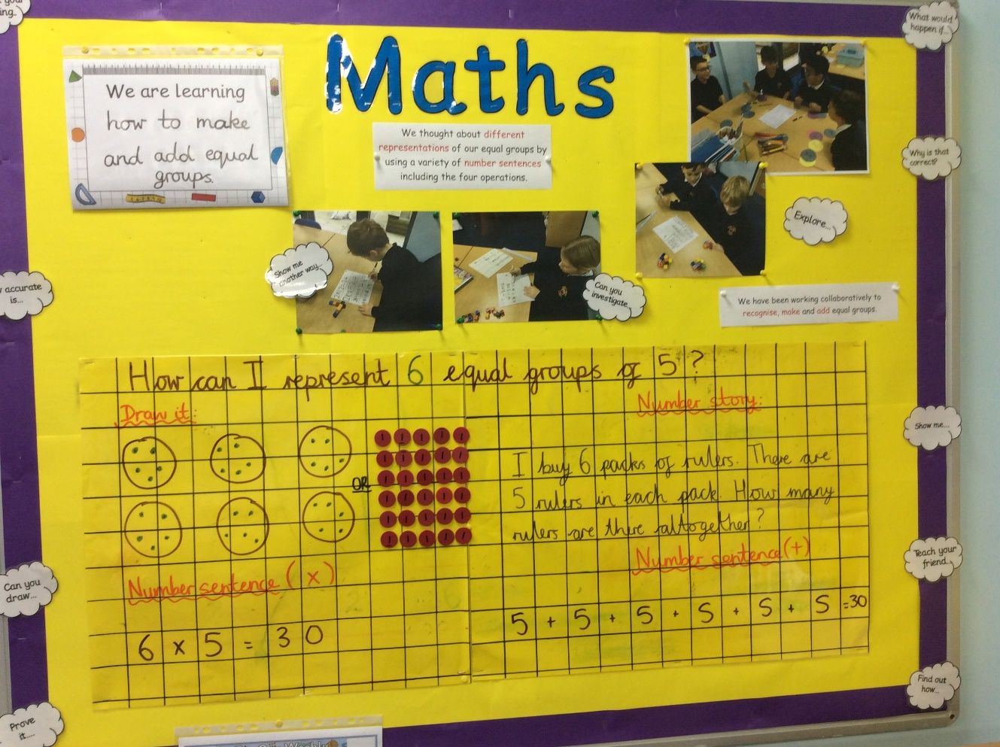
This term in maths, Year 3 pupils have been representing multiplication in different ways.

Slide 6
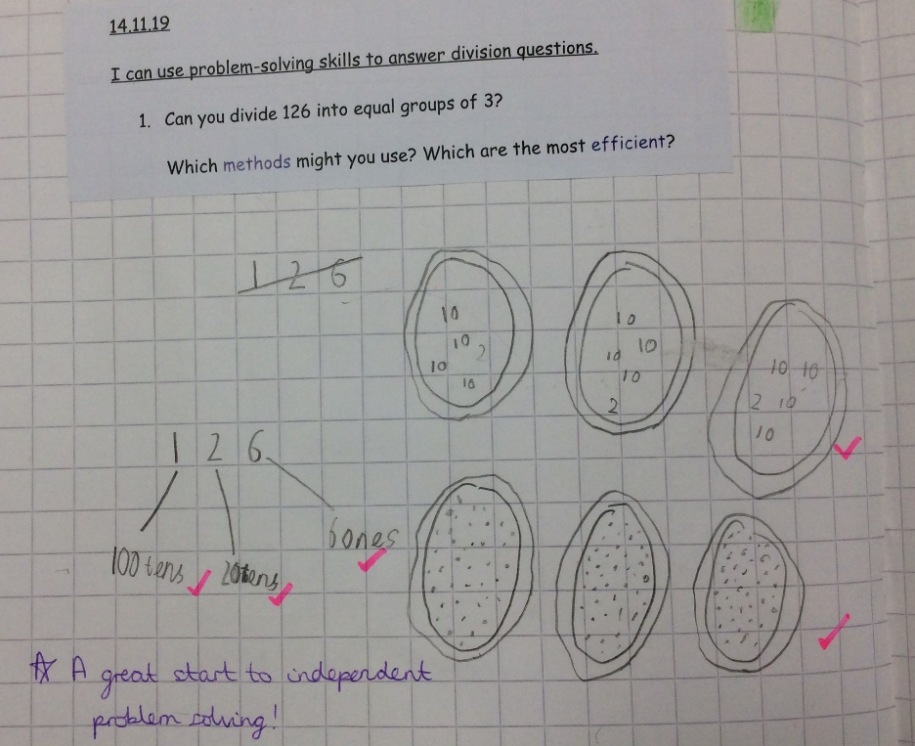
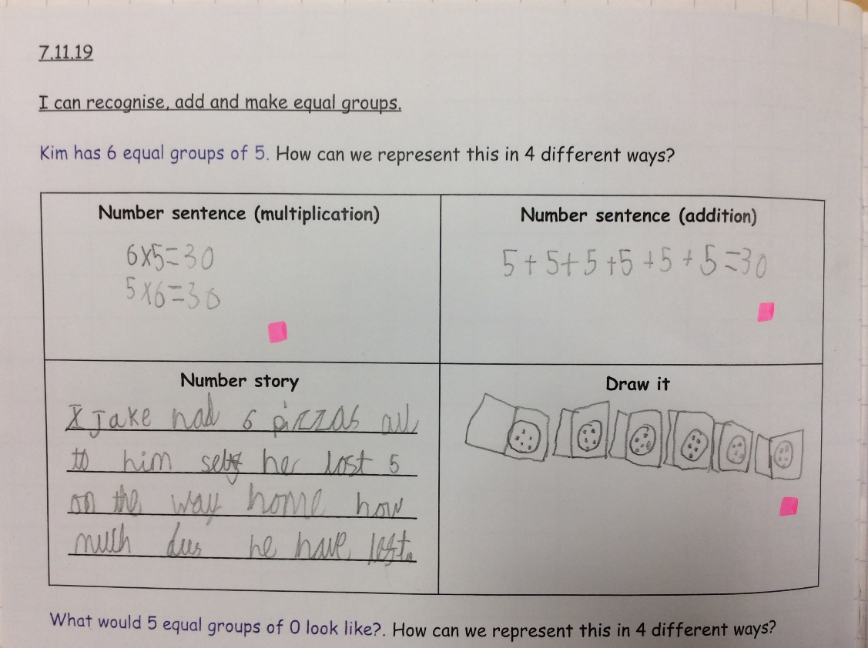
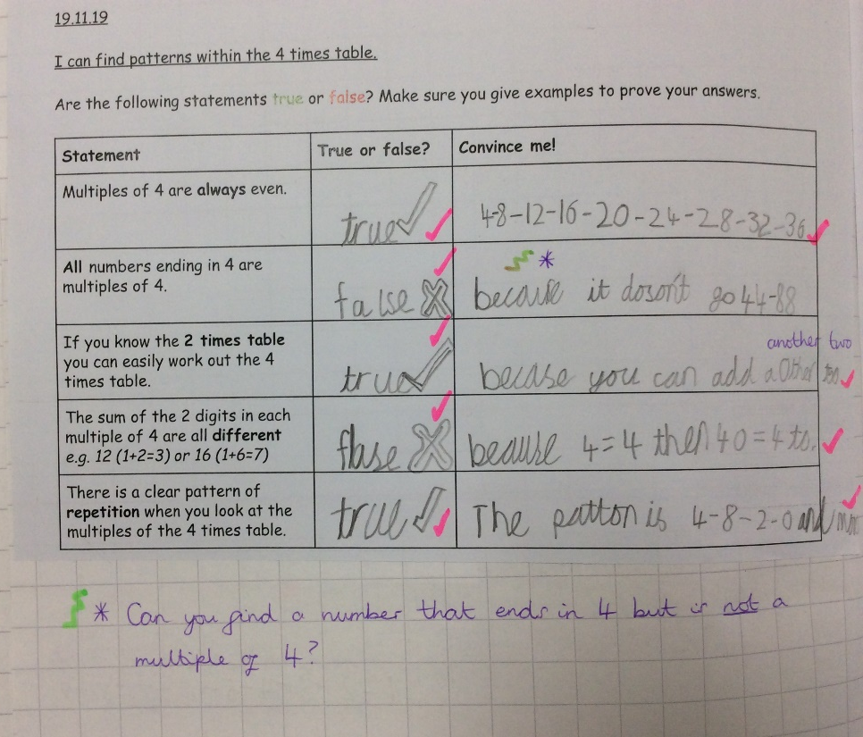
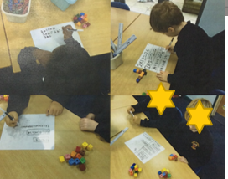
Look at how well we have been able to show our understanding in lots of ways!

Slide 7
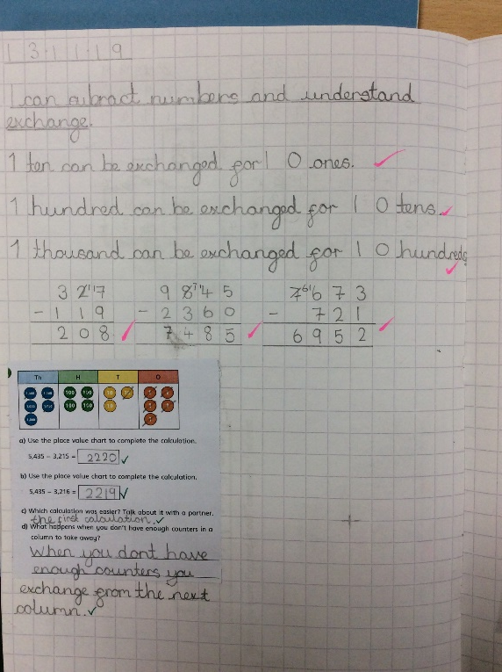
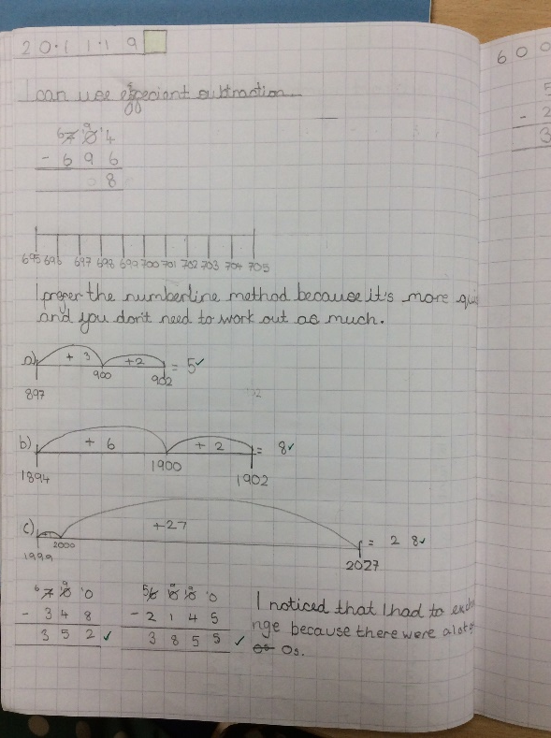
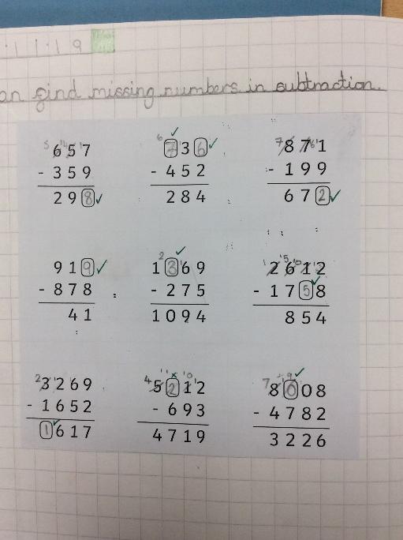
Year 4 pupils have been exploring addition and subtraction in more depth. We have been testing methods to see which is most efficient and were challenged to answer calculations with missing numbers.
We have become more able to explain our thinking using words and diagrams.

Slide 8
We have really enjoyed our learning this half term. Our topic ‘Let there be light’ has given us lots of opportunities to find out about light through our topic and science work.

Slide 9
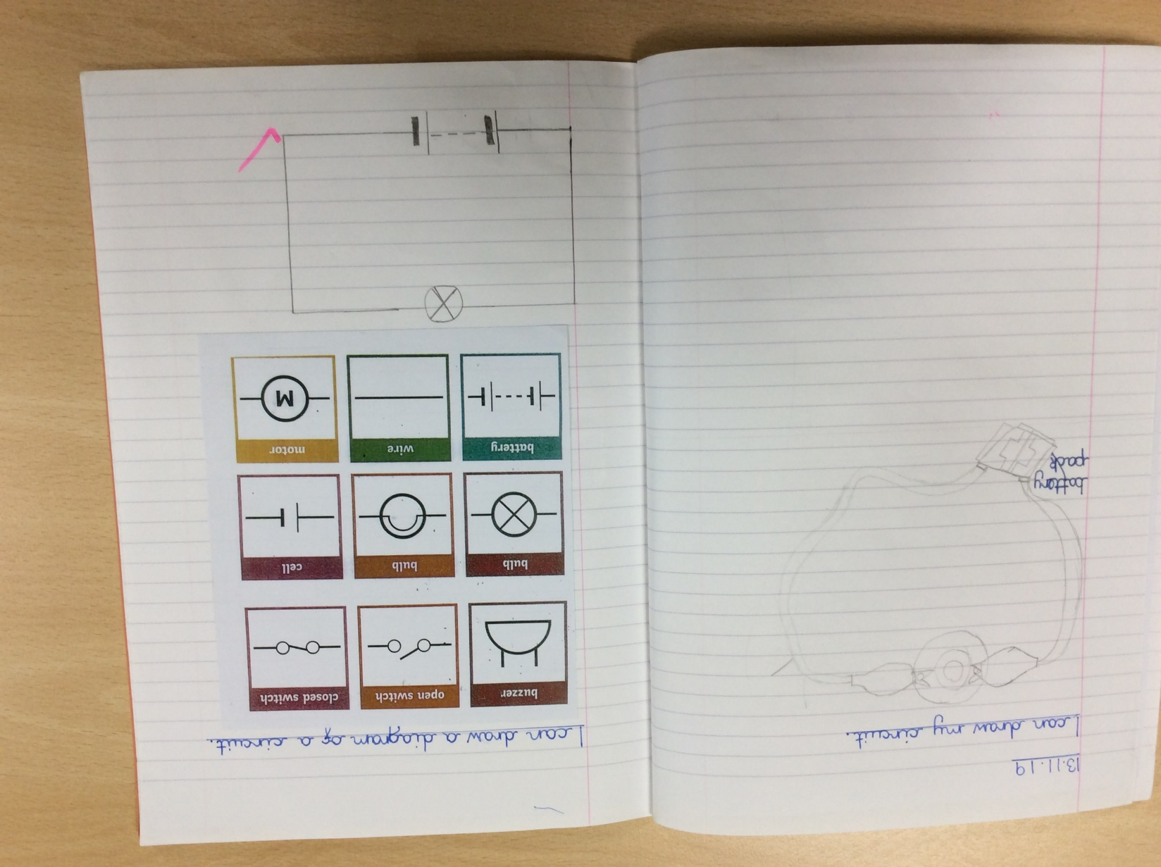
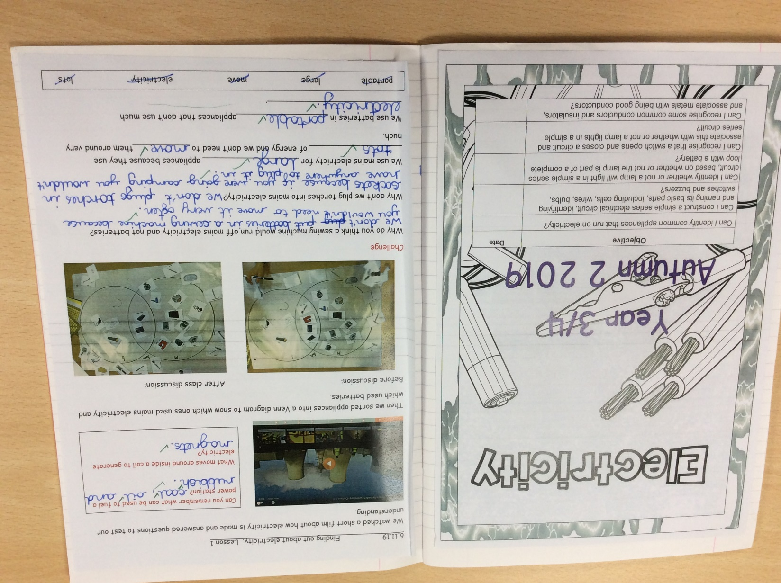
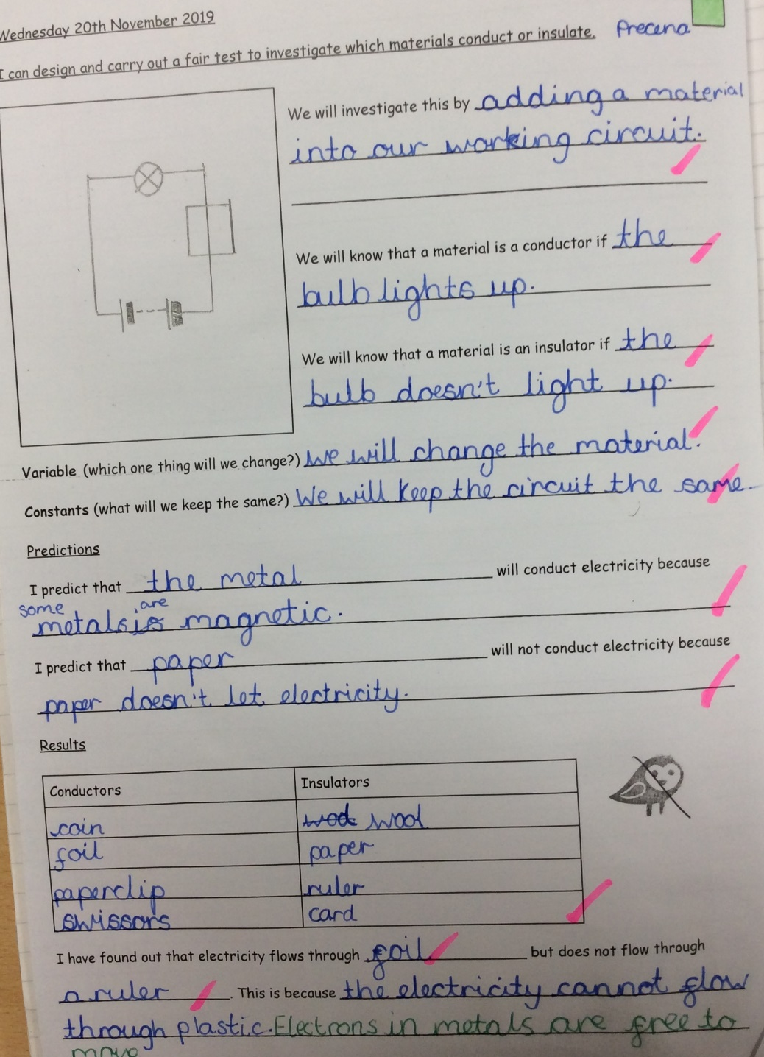
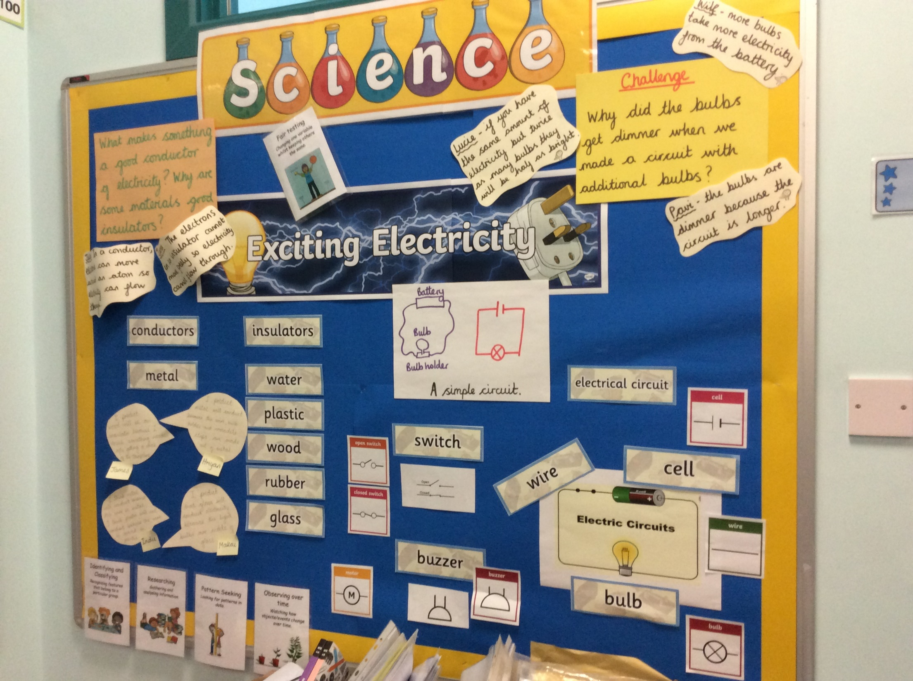
Our science learning journey…
We then were challenged to make a bulb light up! We finally succeeded. In our next lesson, we learned how to draw our circuits as a diagram.
We found out how electricity is made and which devices use main electricity or batteries.
We then tested different materials – which would conduct electricity and which would be insulators?

Slide 10
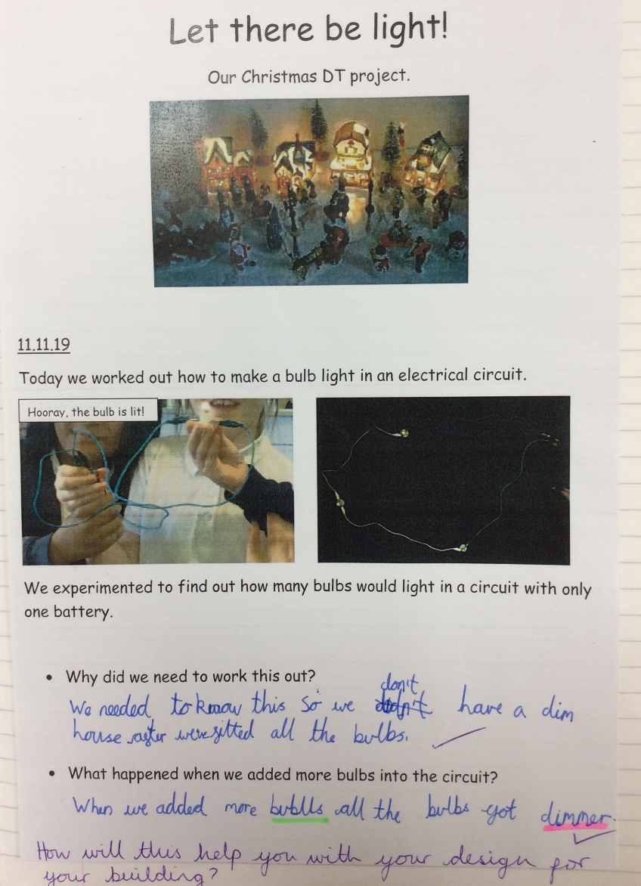
In topic lessons, we used our scientific skills to help us design and make a light-up box building.

Slide 11
Our finished Christmas village was beautiful…

Slide 12
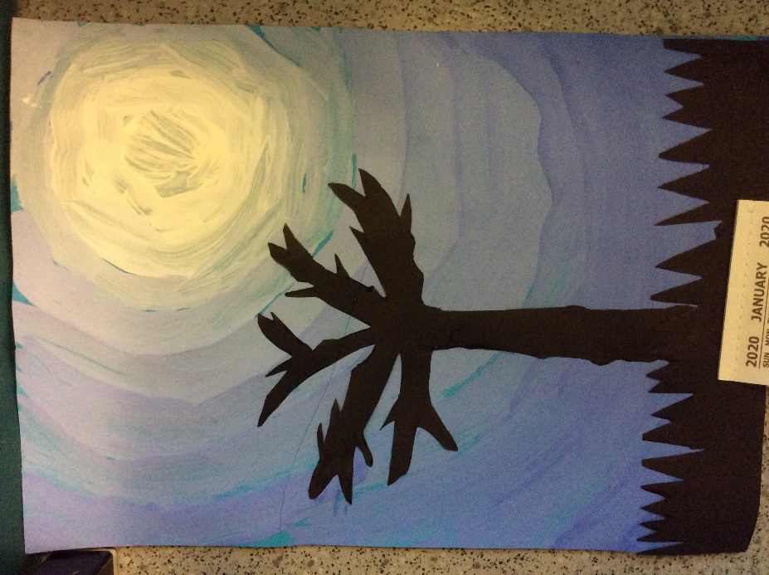
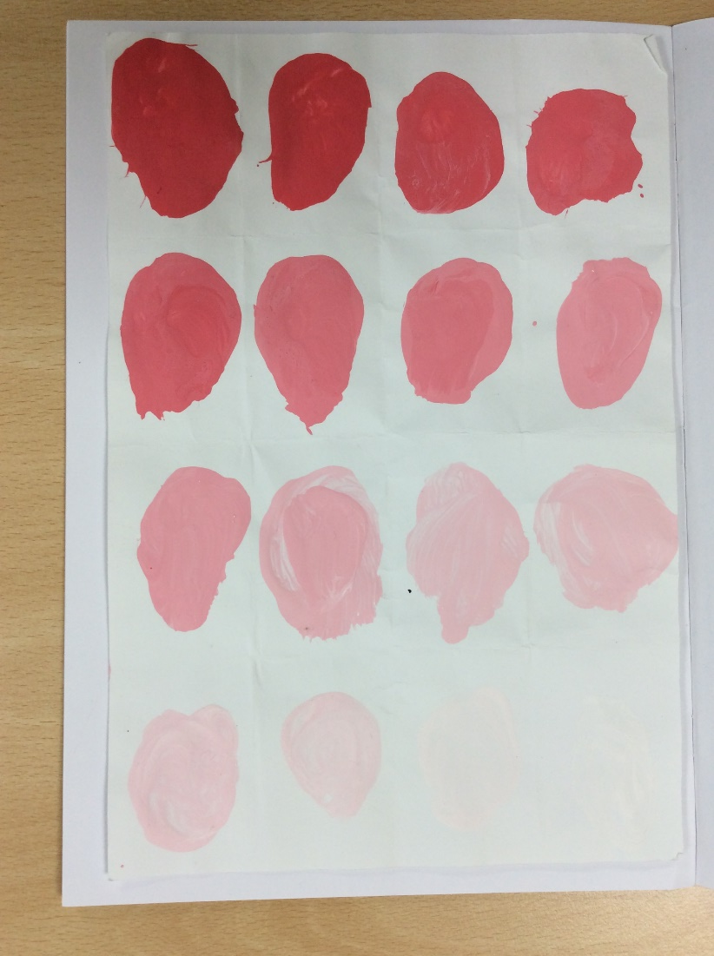
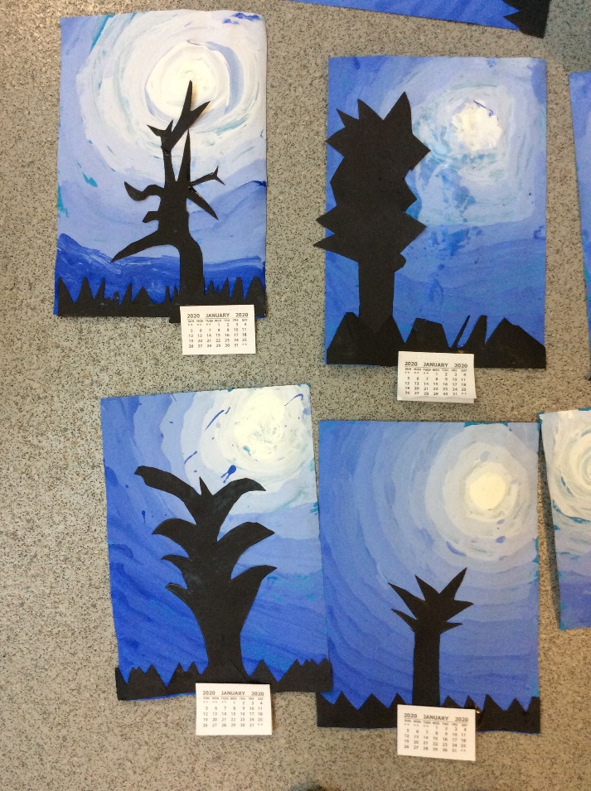
In art, we have developed our ability to mix colours and to make different tones of the same colour.
We applied these skills to create an effective landscape. They were so effective, we decided to give them as Christmas gifts!

Slide 13
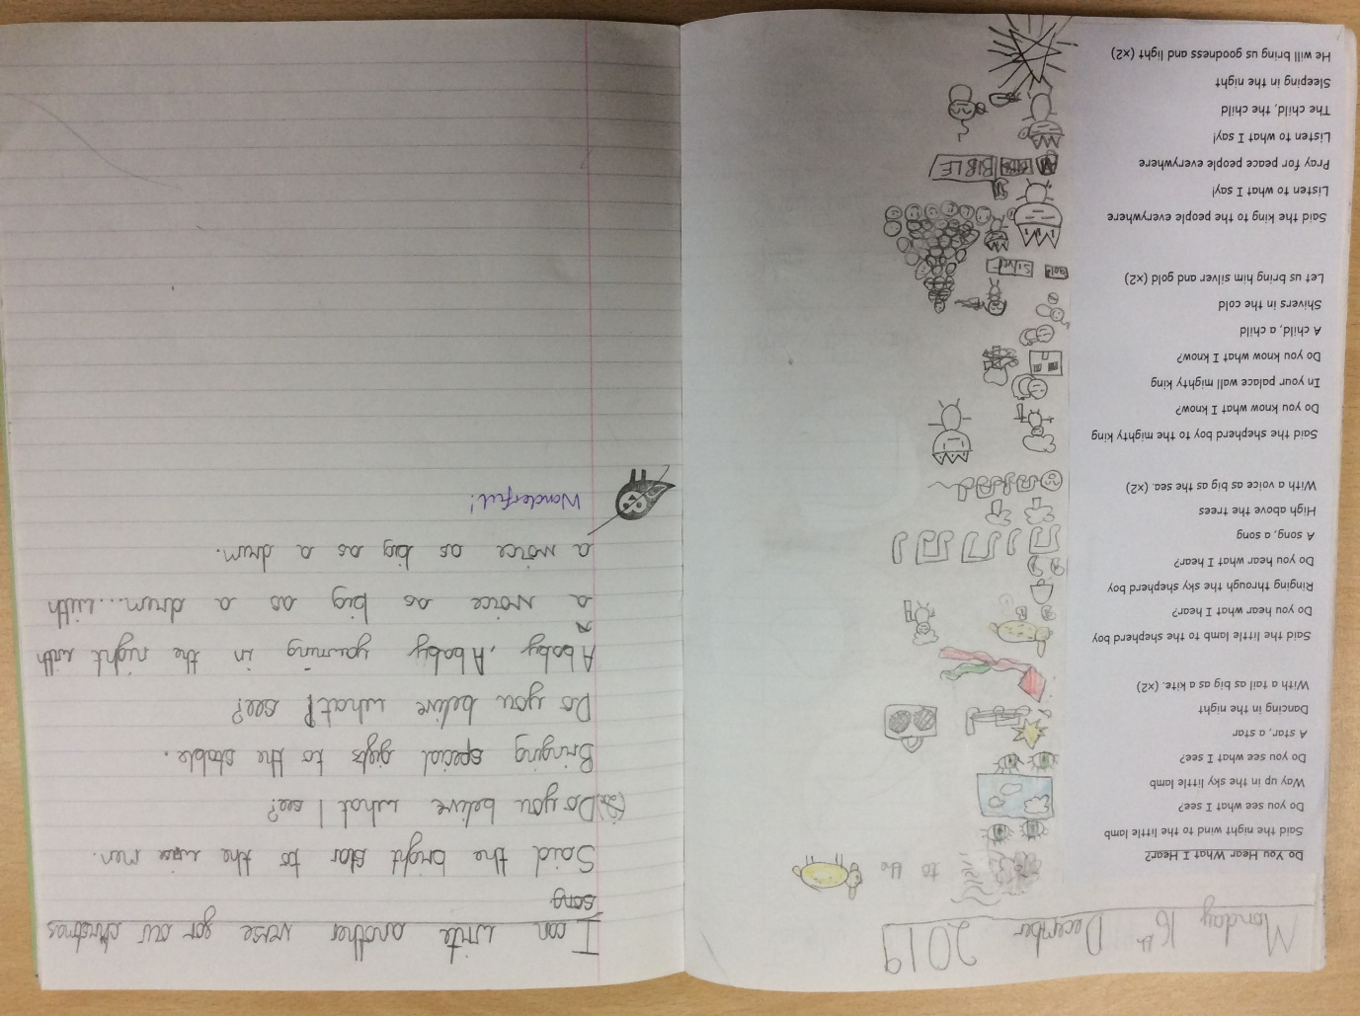
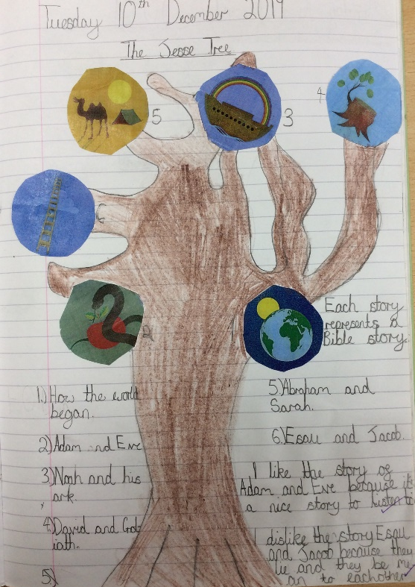
In RE, we have continued to consider what it means to be a Christian in Britain today. We have spent a lot of time thinking about what Christmas means to Christians especially.

Slide 14
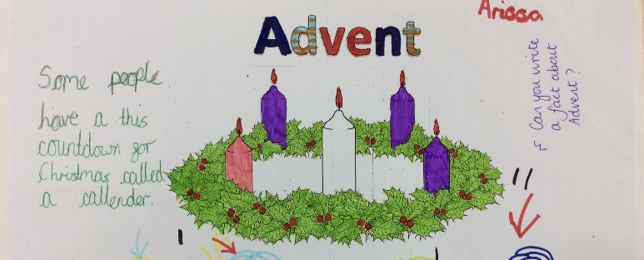
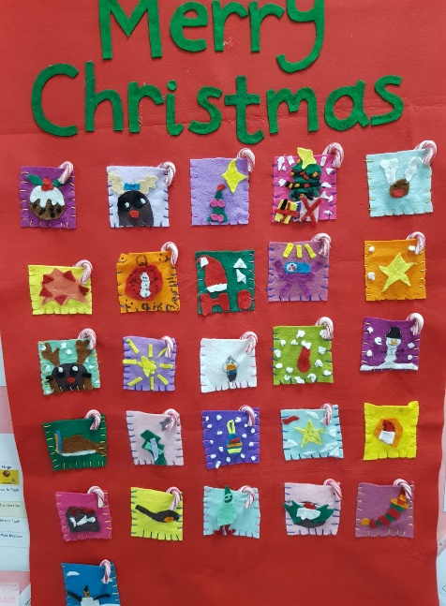
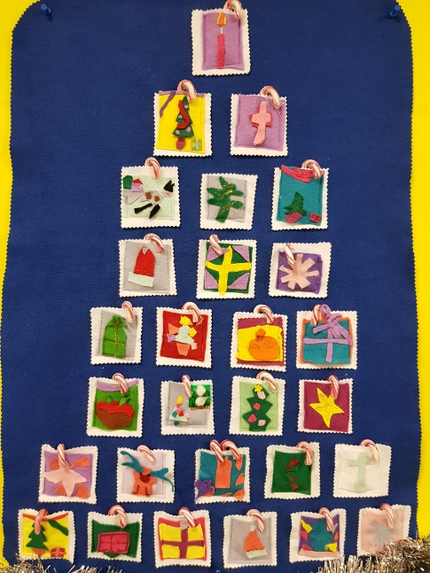
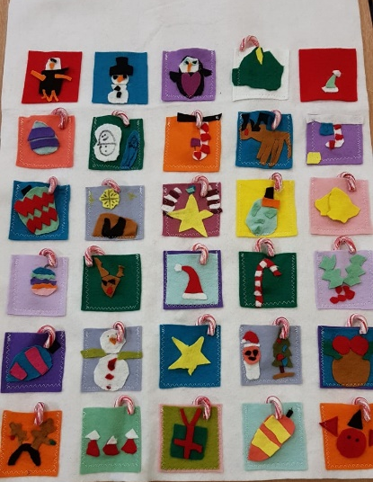
We have learned about the tradition of advent and how it is celebrated in church. Each class collaborated to make their own advent calendar.
Miss Mondon’s Class
Mrs Haxby’s and Miss Ramsay’s Class
Mrs Usher’s Class

Slide 15
In PE, we choreographed, rehearsed and performed our own dance routines. Each class was very different but all the performances were fantastic! Each dance had the title ‘Let there be light’.
Miss Ramsay’s group – Walking on Sunshine
Mrs Usher’s group – Rule the World
Ms Thomspon’s group – Firework

Slide 16
Thank you for sharing our learning journey ☺

